Slide 1
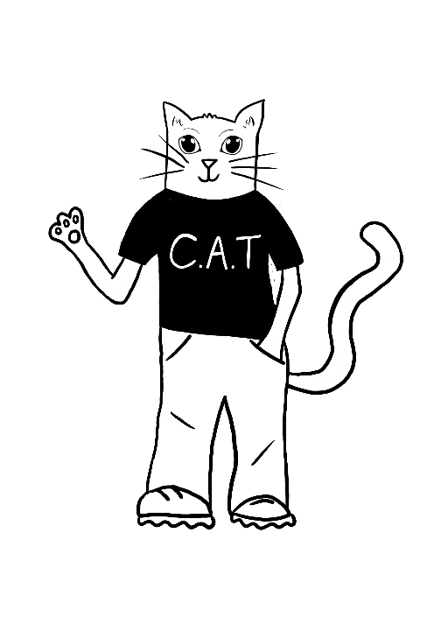
CLIMATE ACTION TEAM
PAPER USAGE & WASTE
Session 1

Slide 2
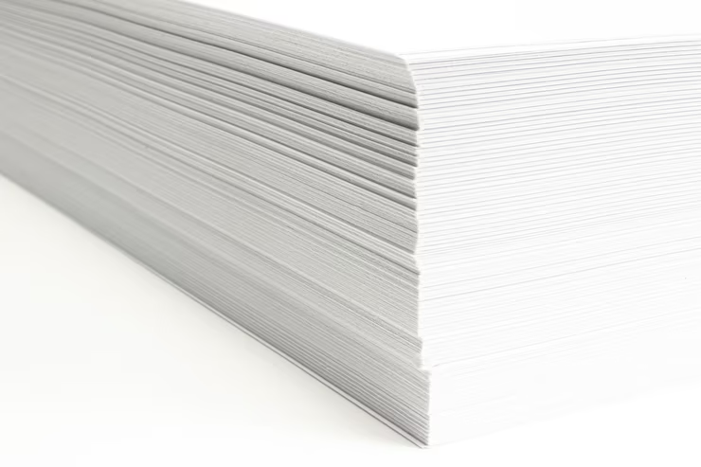
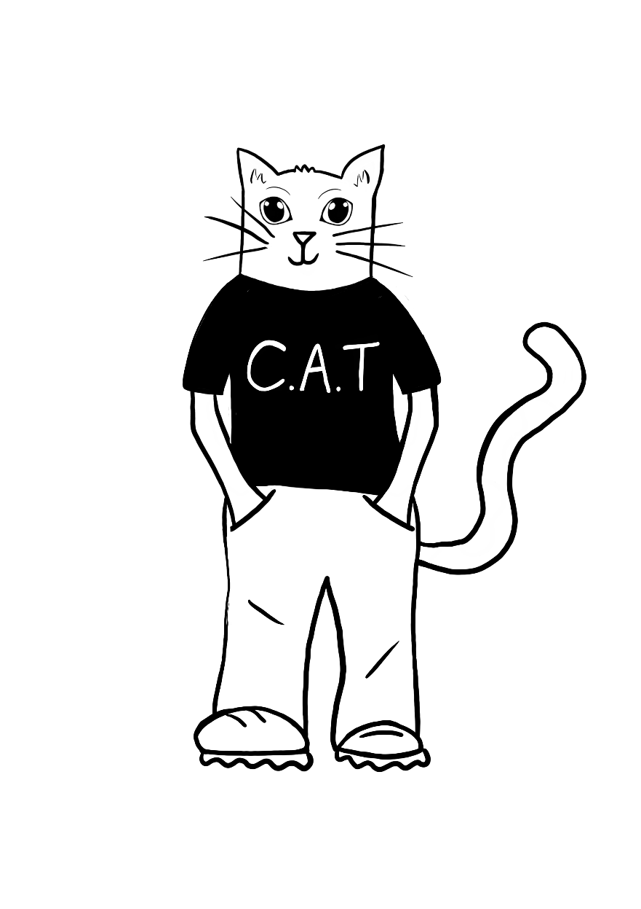
PAPER IS GREAT … RIGHT?
Paper is an incredibly useful material, especially in schools, but the amount of paper that we use each day is harming our environment.
How many different uses of paper can you think of in your school?
Let’s take a look at how it impacts the world around us.

Slide 3
PRODUCTION OF PAPER
First let’s take a look at the paper making process.

Slide 4
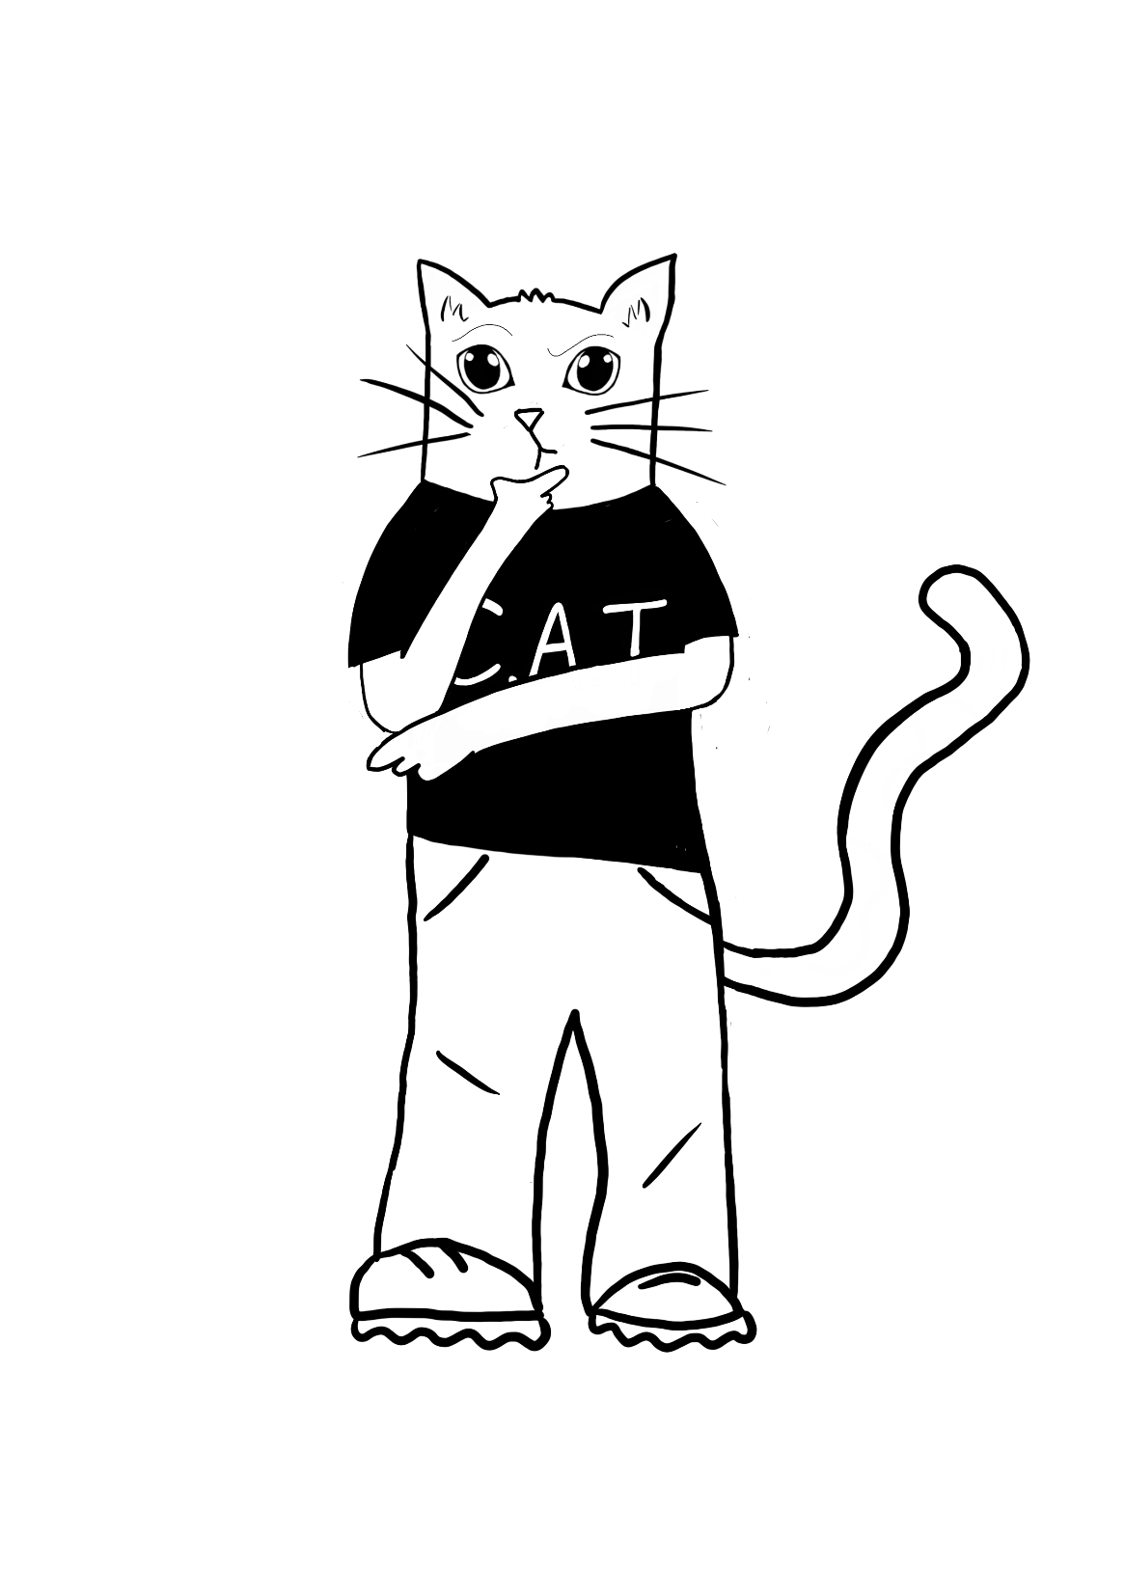
PRODUCTION OF PAPER
Do you think the production of paper harms the environment?
Did you notice anything in the video that could be harming the environment and adding to the climate crisis?

Slide 5
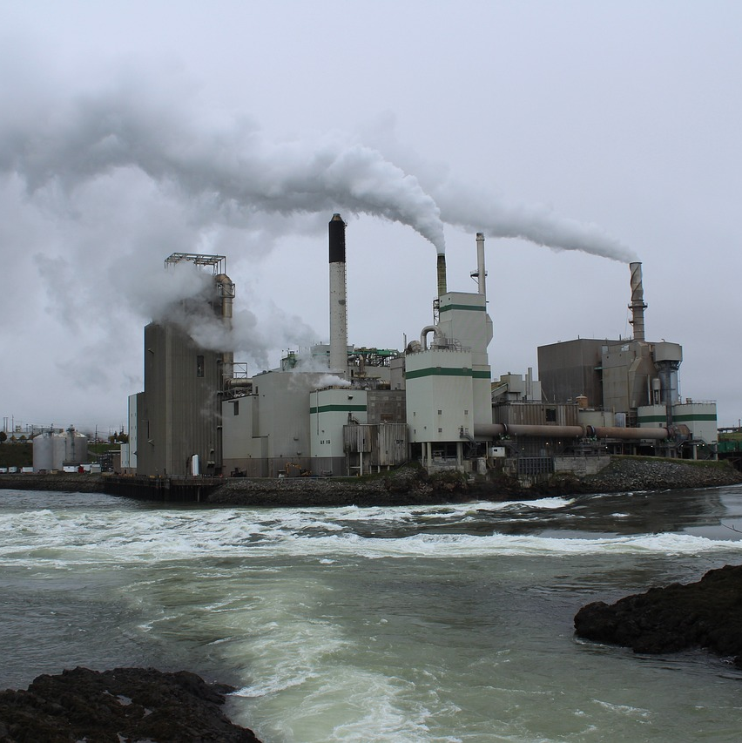
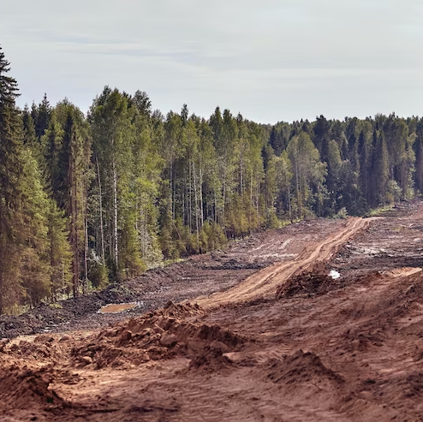
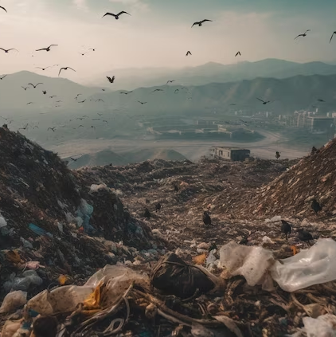
THE DAMAGE CAUSED
Here are a few ways that the need for paper is damaging the environment.
Papermaking releases chemicals into the air increasing air pollution, damaging our health and contributing to the climate crisis.
Paper is made from trees meaning that papermaking encourages deforestation, endangering the animals that live there.
The process of papermaking can pollute water supplies and creates an enormous amount of waste.

Slide 6
PAPER USAGE IN SCHOOLS
Did you know that, each year, UK primary schools create 45kg of paper waste per pupil?
That is approximately 212 million kilograms of paper waste a year!
But what can you do to help?

Slide 7
PAPER USAGE IN YOUR SCHOOL
As a team, you will need to find out how much paper is ordered and used in your school.
You could use the questionnaire provided and ask the head teacher or school business manager to find out how much paper is ordered each year.
You might need to do some maths to find out exactly how many pieces of paper were purchased.

Slide 8
QUESTIONS TO DISCUSS
Before you ask a member of staff about the school’s use of paper, why not discuss the questions as a group first.
What type of paper is purchased throughout the year? E.g. printer paper, recycled paper, cartridge/art paper, coloured paper.
How many sheets of printer paper were purchased last school year?
How many sheets of art paper (including coloured paper & card) were purchased?
Is paper usage monitored / limited or can staff take it when they want to?
Do children have access to plain paper for colouring and drawing?
Where is paper used within the school?

Slide 9
CLIMATE ACTION TEAM
PAPER USAGE & WASTE
Session 2

Slide 10
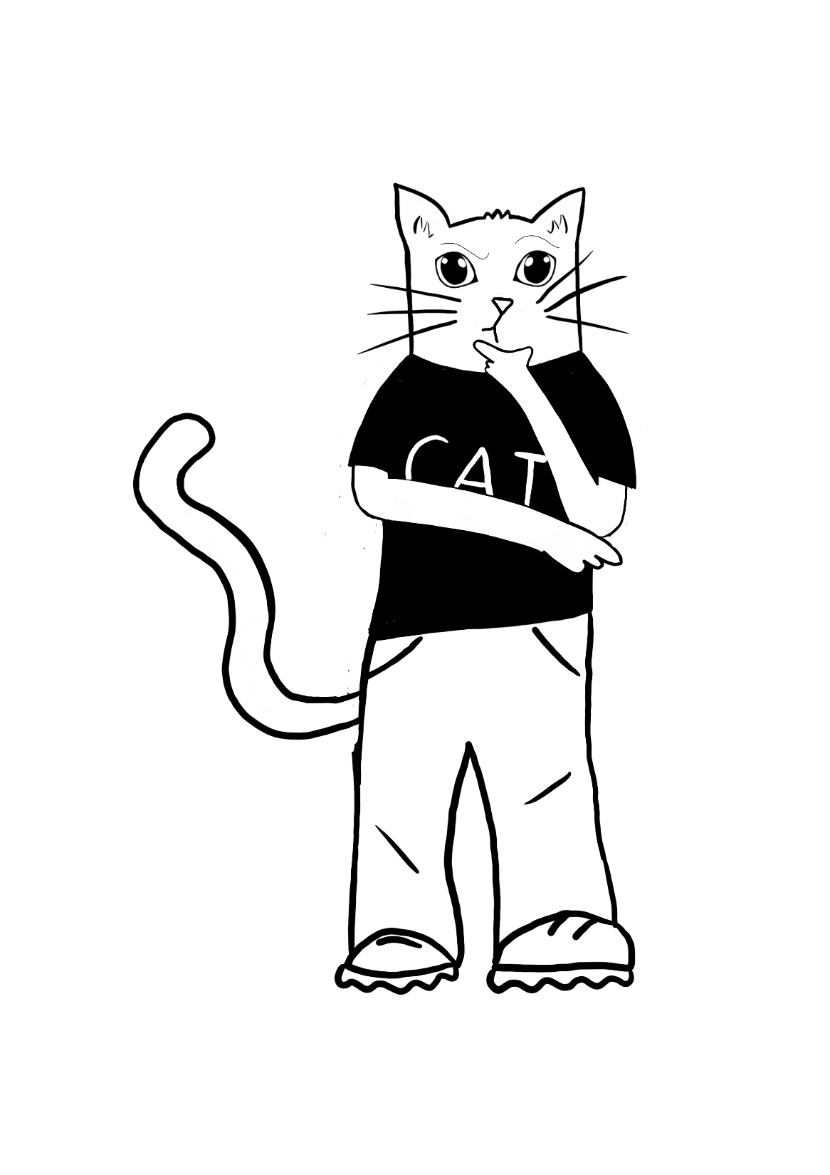
Can you remember how paper usage harms the environment and adds to a school’s climate impact?

Slide 11
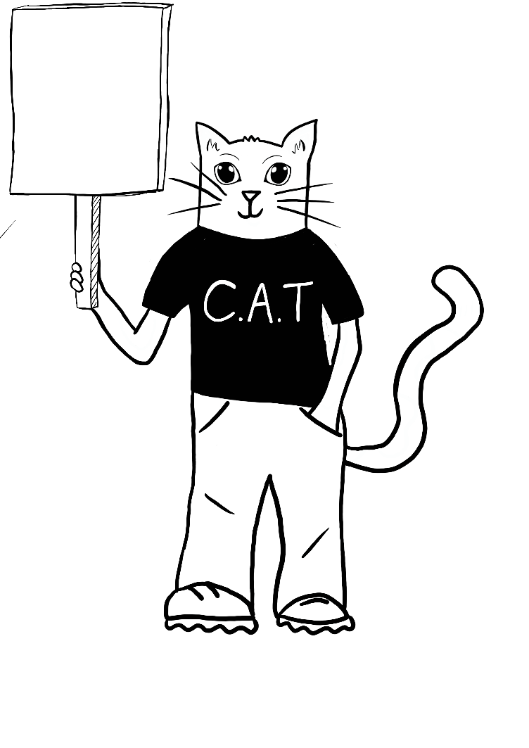
TRUE OR FALSE?
LET’S PLAY A GAME OF TRUE OR FALSE.
If you think that the statement is true, put your thumbs up.
If you think statement is false, put your thumbs down.
Is it true
or false?

Slide 12
TRUE OR FALSE?
Paper production increases air pollution.
Is it true
or false?

Slide 13
TRUE
TRUE OR FALSE?
Paper production increases air pollution.
TRUE
Is it true
or false?

Slide 14
TRUE OR FALSE?
The production of paper uses very little energy.
Is it true
or false?

Slide 15
TRUE OR FALSE?
FALSE
The production of paper uses very little energy.
Is it true
or false?

Slide 16
TRUE OR FALSE?
Manufacturing paper products produces more greenhouse gases than producing plastic packaging.
Is it true
or false?

Slide 17
TRUE OR FALSE?
Manufacturing paper products produces more greenhouse gases than producing plastic packaging.
TRUE
Is it true
or false?

Slide 18
TRUE OR FALSE?
The process of papermaking creates very little waste.
Is it true
or false?

Slide 19
TRUE OR FALSE?
FALSE
The process of papermaking creates very little waste.
Is it true
or false?

Slide 20
TRUE OR FALSE?
Papermaking encourages deforestation, endangering the lives of animals.
Is it true
or false?

Slide 21
TRUE OR FALSE?
TRUE
Papermaking encourages deforestation, endangering the lives of animals.
Is it true
or false?

Slide 22
DID YOU KNOW …
Approximately 26% of the total waste in landfills is created by paper.
Take a look at how much paper has been produced so far this year, using this online counter.
https://www.theworldcounts.com/challenges/consumption/other-products/environmental-impact-of-paper

Slide 23
HOW IS PAPER WASTED
IN YOUR SCHOOL?
It’s time to find out how much paper is wasted in your school and investigate the climate impact it is having.
As a group, brainstorm what you think the main reasons for paper waste could be in your school.

Slide 24
LET’S GET INVESTIGATING!
In order to take action against paper waste, you first need to find out the main reasons for the waste.
Use the C.A.T paper waste audit to find out what is going on in your school.

Slide 25
ACTION AT HOME!
Are your families aware of the impact that paper production has on the environment?
Do other families in your school know?
Why not create something electronically that can be shared with your own families and others to raise awareness.
Here are a few ideas!
Poster
Website
Presentation
Video

Slide 26
CLIMATE ACTION TEAM
PAPER USAGE & WASTE
Session 3

Slide 27
TAKING ACTION!
Now that you know which areas in your school are having the largest impact due to paper waste, you can start to take action.
As a group, discuss what you found out from conducting your paper waste audit and brainstorm some ideas to help reduce the impact.

Slide 28
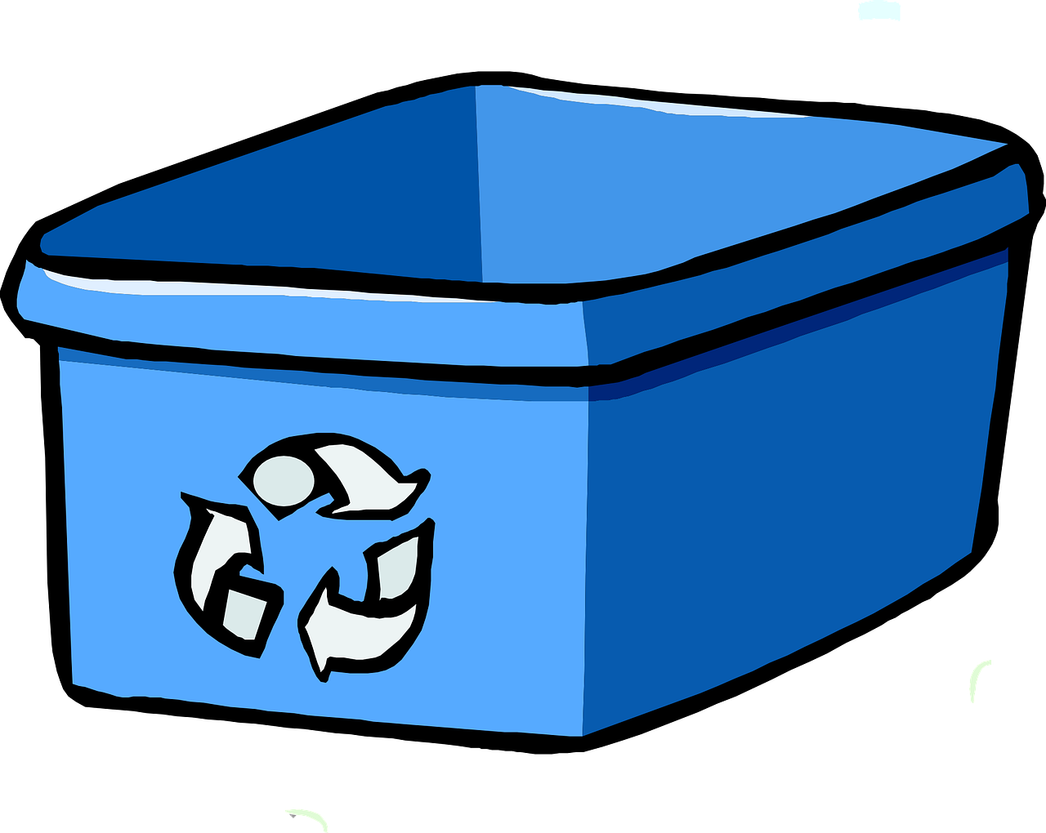
NEED MORE IDEAS?
We’re sure that you all came up with great ideas to reduce your school’s climate impact from paper waste.
Here are a few ideas in case you didn’t think of them.
Ensure that each room has a paper recycling bin.

Slide 29
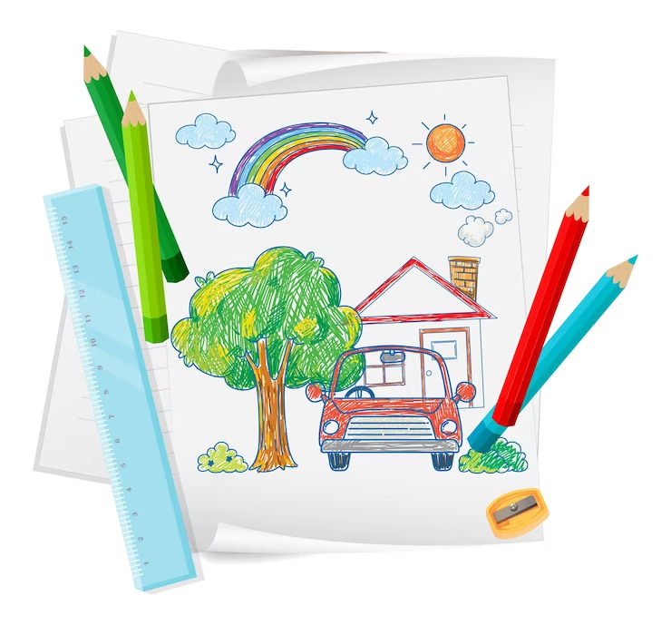
Ensure that all classes have a scrap paper draw/box that children can use for drawing etc. instead of new paper.
Educate the rest of the school community on the impact of paper production and waste (pupils, members of staff and families).

Slide 30
Encourage teachers to set homework online.
Send information home to parents via email or online platforms e.g. letters and newsletters.
Use recycled paper where you can.

Slide 31
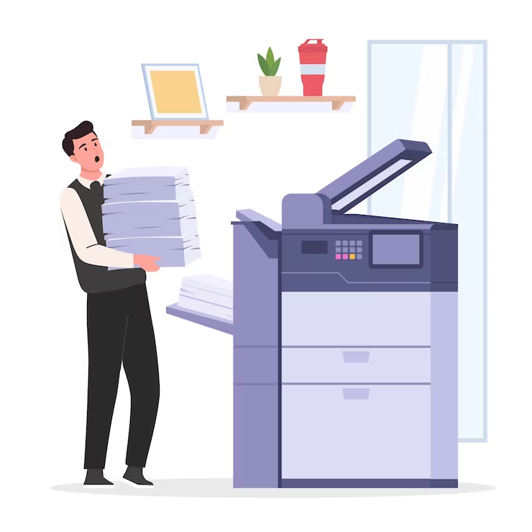
Encourage people to only print what they need.
Have paper allocations for each class per half term to encourage people to think about how much they are using.

Slide 32
ACTION PLANNING
As a team, create your own action plan to tackle paper wastage and reduce paper usage in your school.
You can create your own action plan or use the C.A.T template.

Slide 33
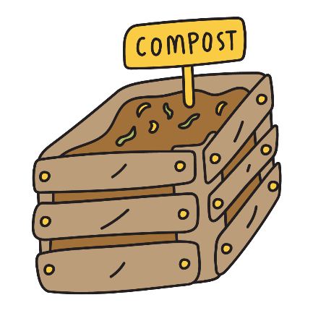
TAKING ACTION AT HOME!
What can you do at home?
There are lots of ways that you can reduce paper usage and waste in your own home.
Create a poster to stop people putting junk mail through your letter box.
Shred brown paper and use it in your compost.
Go paperless as a family e.g. bank statements.

Slide 34
IMAGE CREDITS
Slide(s) | Photo | Attribution
2 | Paper stack | By Icd2020 via freepik
3 | Paper mill | By Adplace via Pixabay
3 | Deforestation | By YuliiaKa via freepik
3 & 20 | Landfill | By stockgiu via freepik
5 | Audit | By studiogstock via freepik
29 | Drawing | By brgfx via freepik
29 | Family | By Pikisuperstar viafreepik
30 | Computer | By storyset via freepik
30 | Paper | By Rawpixel.com via Freepik
31 | Printer | By Freepik via Freepik

