Slide 1
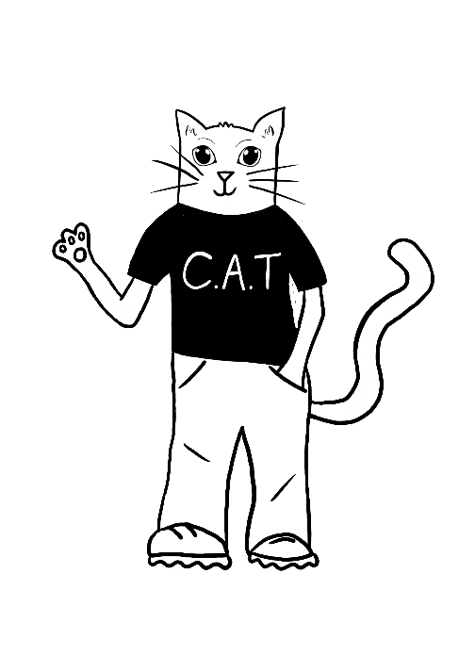
CLIMATE ACTION TEAM
WATER USAGE
& WASTE
Session 1

Slide 2
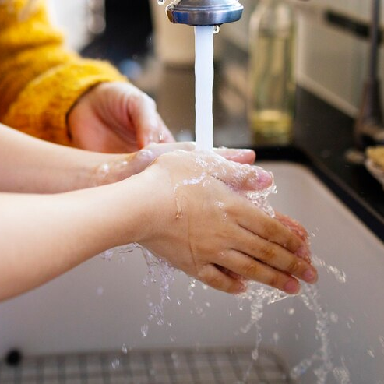
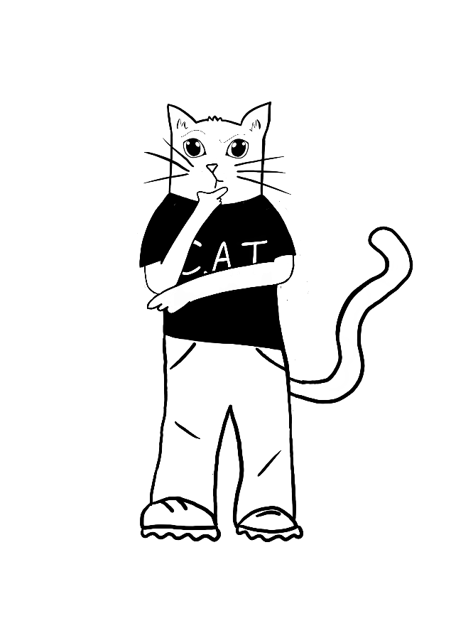
WONDERFUL WATER!
Where does water come from?
Did you know that clean water is a limited resource and a very costly one?
Do you know where our clean water comes from?

Slide 3
THE WATER CYCLE
It all begins with the water cycle.
Stop at 4:03

Slide 4
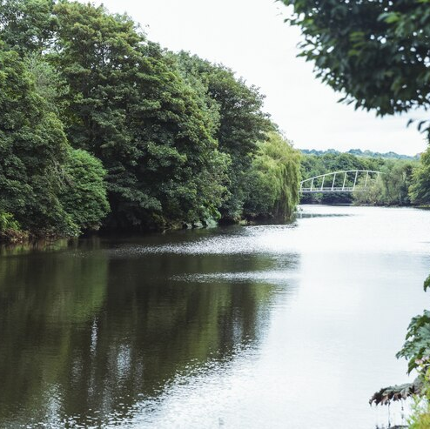
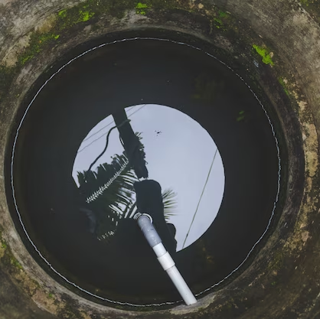
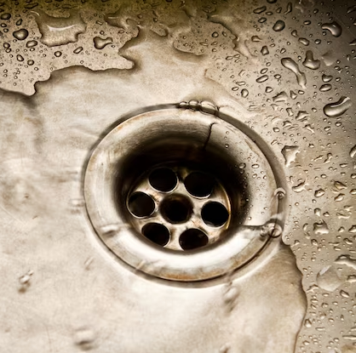
WHAT HAPPENS NEXT?
Water treatment facilities then gather the
water to clean and send it to you.
This water can come from different places.
SURFACE WATER
Rivers, lakes and reservoirs
GROUND WATER
Natural
underground
stores
SEWER NETWORK
Used
water

Slide 5
WATER TREATMENT
The water then needs to be cleaned.

Slide 6
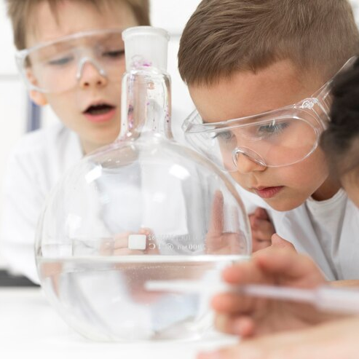
HOW DO YOU USE WATER IN YOUR SCHOOL?
Drinking water is essential in order to survive but it is also used for lots of other reasons.
Can you think of all the ways that water is used in your school?
You could create a mind map or a floor plan of the school to indicate where water is used in your school.

Slide 7
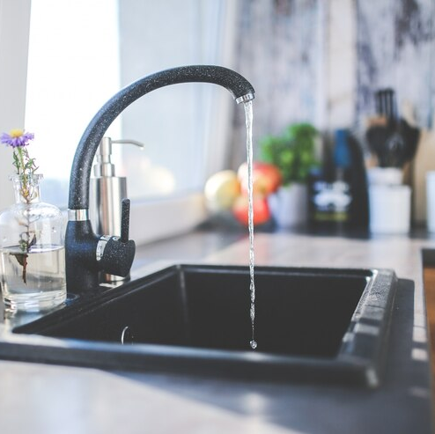
HOME ACTIVITY
It’s time to investigate your use of water at home.
Over the next week, investigate how water is used by your family.
Don’t forget to keep an eye out in the garden as well!

Slide 8
CLIMATE ACTION TEAM
WATER USAGE
& WASTE
Session 2

Slide 9
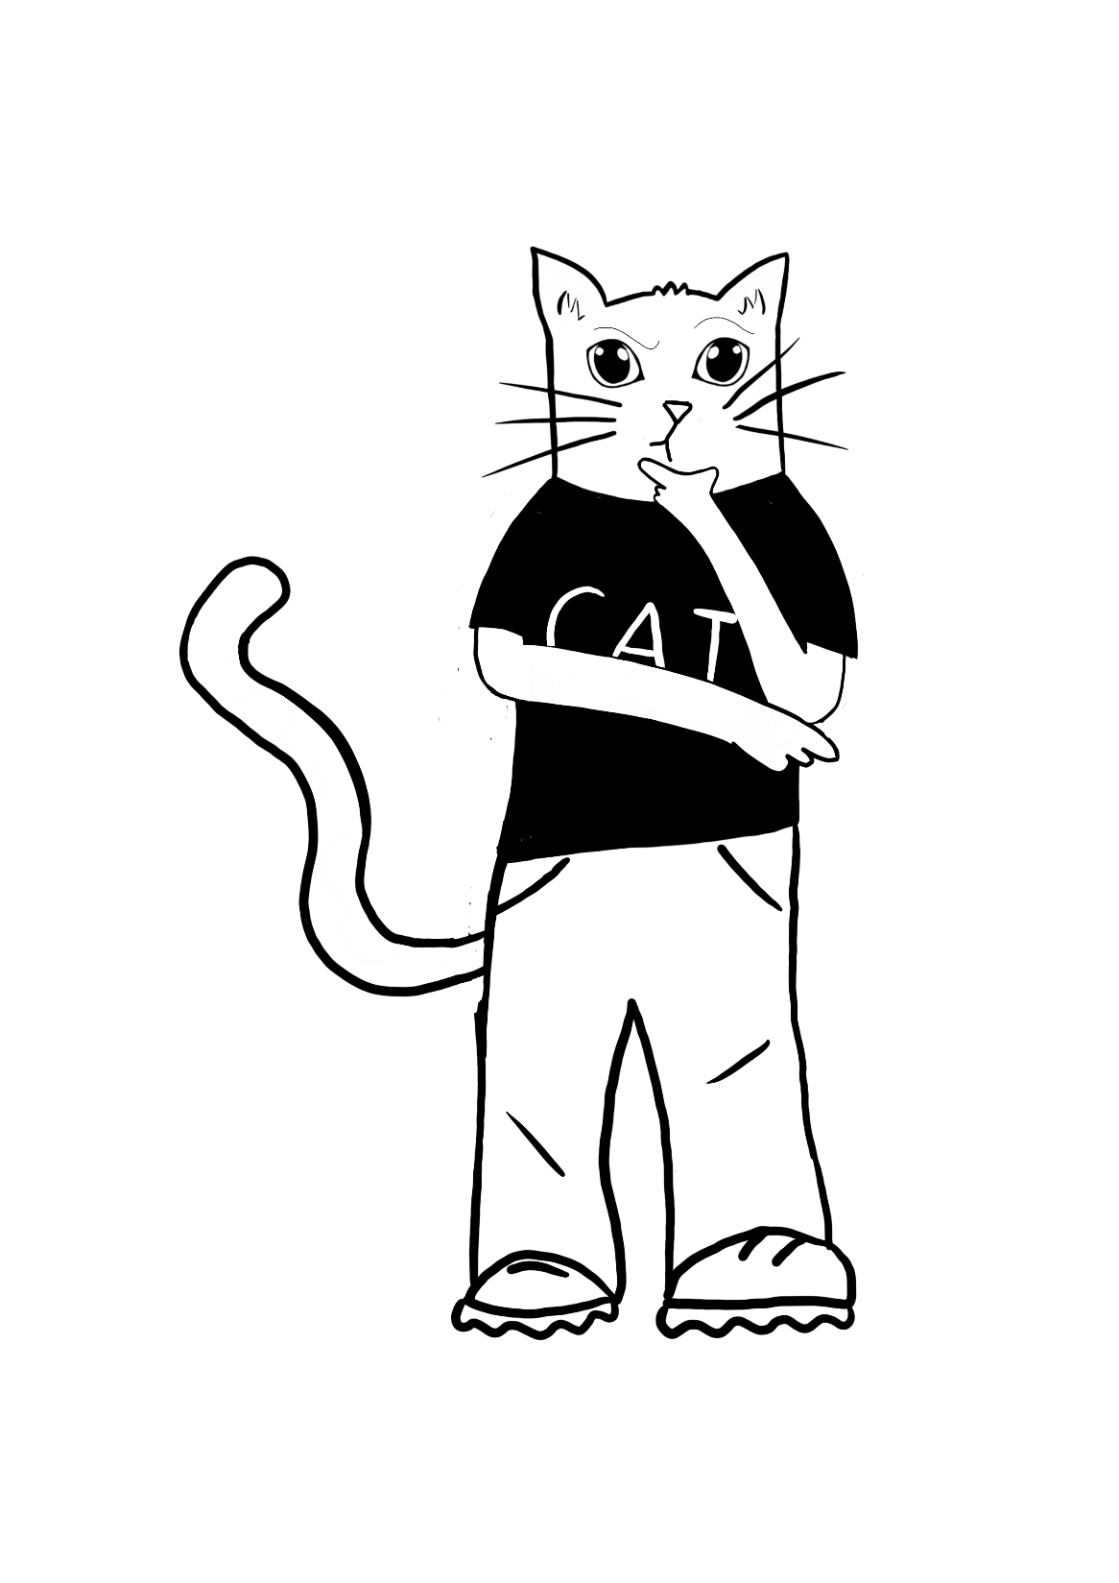
Can you remember how water is cleaned and supplied to you?
Let’s play a quick game!

Slide 10
ALWAYS, SOMETIMES, NEVER
LET’S PLAY A GAME OF ALWAYS, SOMETIMES, NEVER.
Sort the statements in to three piles (always, sometimes, never).
You could play in teams or as individuals.
Who can remember the most?

Slide 11
ENDLESS WATER?
Is water really endless?
What do you think?

Slide 12
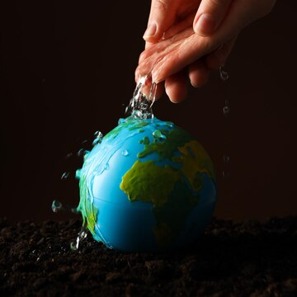
ENDLESS WATER?
It’s easy to think that water is endless, especially when we have rainy days or see rivers, lakes and oceans.
While the planet may never run out of water, it’s important to remember that most of the Earth’s water is salt water, frozen or found underground.

Slide 13
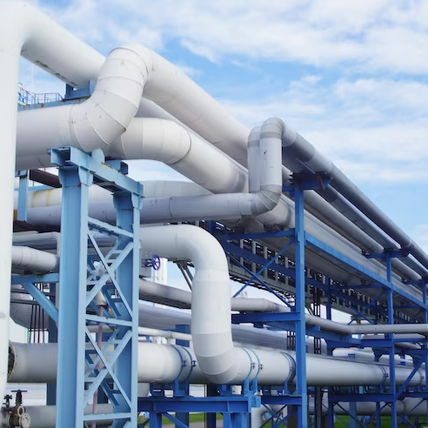
WATER ON EARTH
71% of our planet it covered in water.
That’s a lot, right?
Well actually, only 1% of that water is drinkable.
As the population on Earth increases, so does our need for fresh drinking water.
Treating water, in order to produce clean drinking water, uses a lot a electricity and money.

Slide 14
USING WATER
Producing clean, fresh water uses a large amount of energy and therefore increases our climate impact on the world.
It is important that we save energy by limiting the amount of water that we use and waste.
Let’s get investigating your school’s water usage.

Slide 15
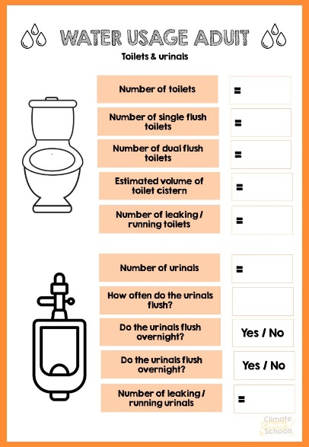
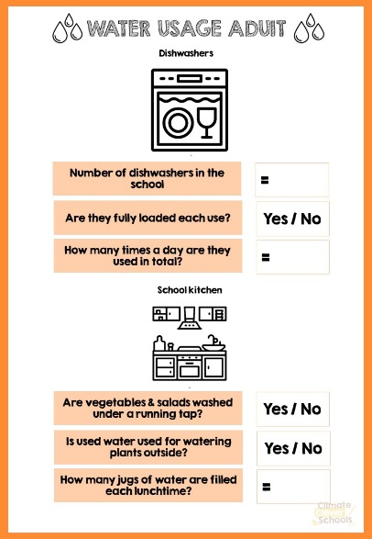
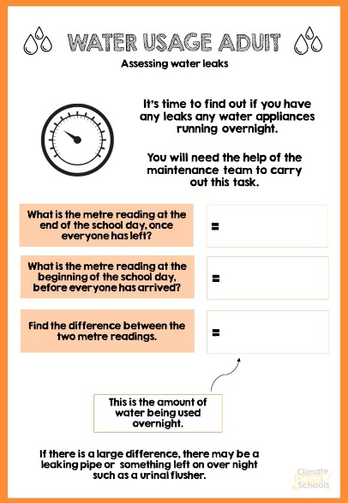
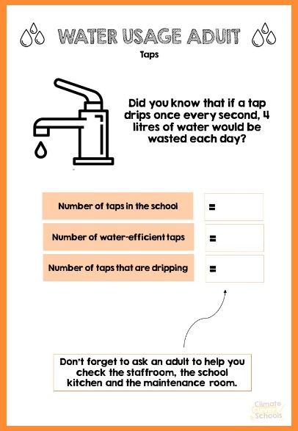
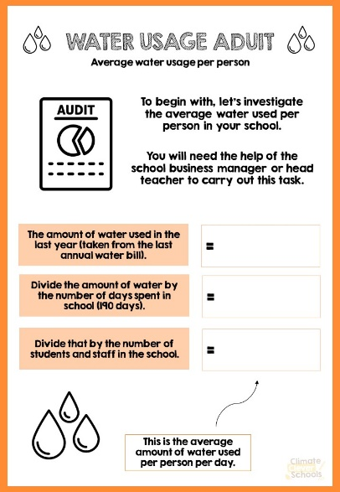
LET’S GET INVESTIGATING!
WATER USAGE AUDIT
It’s time to find out how much water is being used / wasted in your school .
As a group, complete the C.A.T Water Usage Audit to find out how much is being used.
Remember to work as a team.

Slide 16
HOME ACTIVITY
It’s time to investigate your use of water at home further.
Over the next week, you will need to track your own water consumption at home.
Don’t forget to share all the facts that you have learnt with your families.

Slide 17
CLIMATE ACTION TEAM
WATER USAGE
& WASTE
Session 3

Slide 18
TAKING ACTION!
Now that you know which areas in your school are having the largest climate impact due to water usage & waste, you can start to take action.
As a group, discuss what you found out from conducting your water usage audit and brainstorm some ideas to help reduce the impact.

Slide 19
NEED MORE IDEAS?
We’re sure that you all came up with great ideas to reduce your school’s climate impact from water usage & waste.
Here are a few ideas in case you didn’t think of them.
Ensure that each tap has a water saving label / poster near it in order to remind people to use less water.

Slide 20
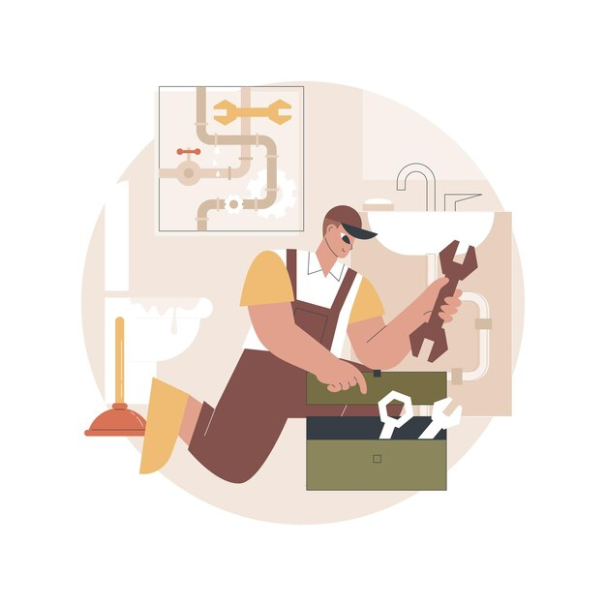
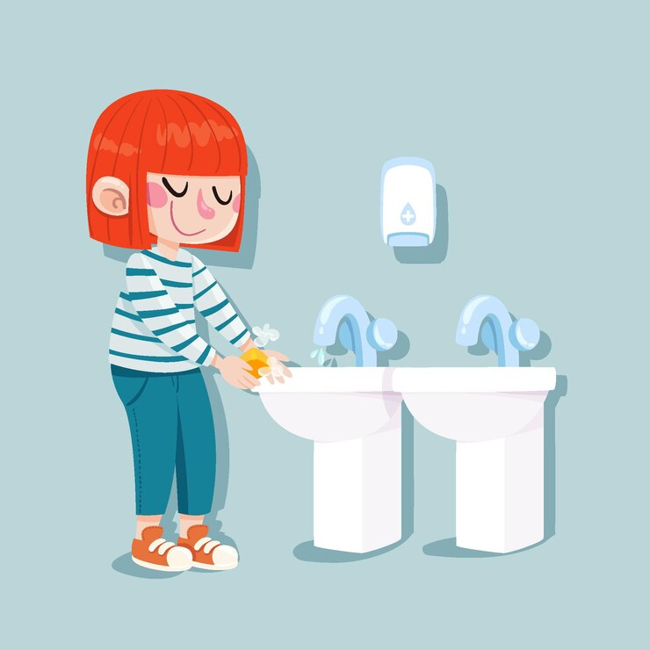
Find any leaks and ask the school maintenance team to fix them.
Replace taps with water-saving versions like push buttons taps.

Slide 21
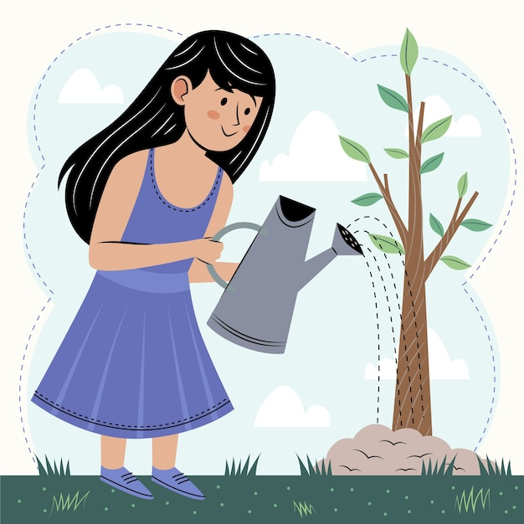
Harvest rainwater to water plants in order to prevent people from using fresh water.
Fit water saving devices to toilets and urinals to reduce the amount of water they use.

Slide 22
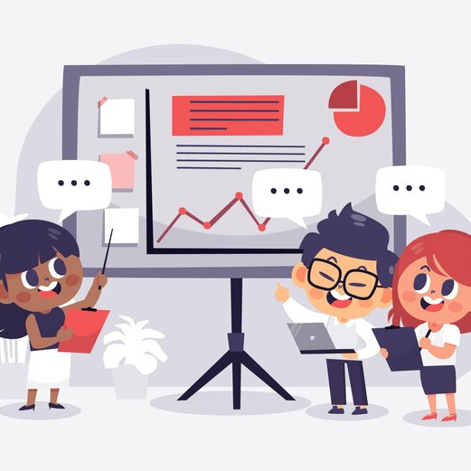
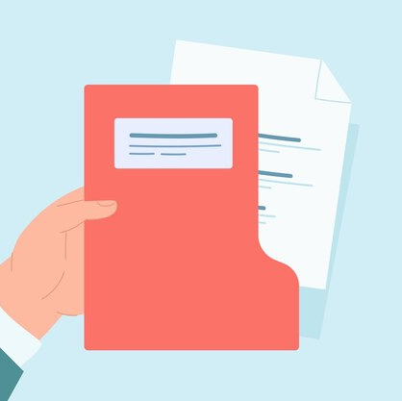
Educate staff and pupils by presenting the information you have learnt to them.
Share this government blog with your head teacher
https://buyingforschools.blog.gov.uk/2022/05/23/how-to-make-your-school-more-water-efficient/

Slide 23
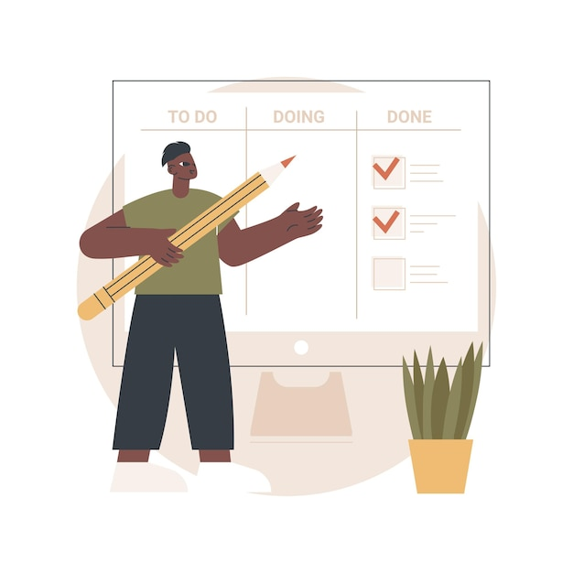
ACTION PLANNING
As a team, create your own action plan to tackle and reduce water usage in your school.
You can create your own action plan or use the C.A.T template.

Slide 24
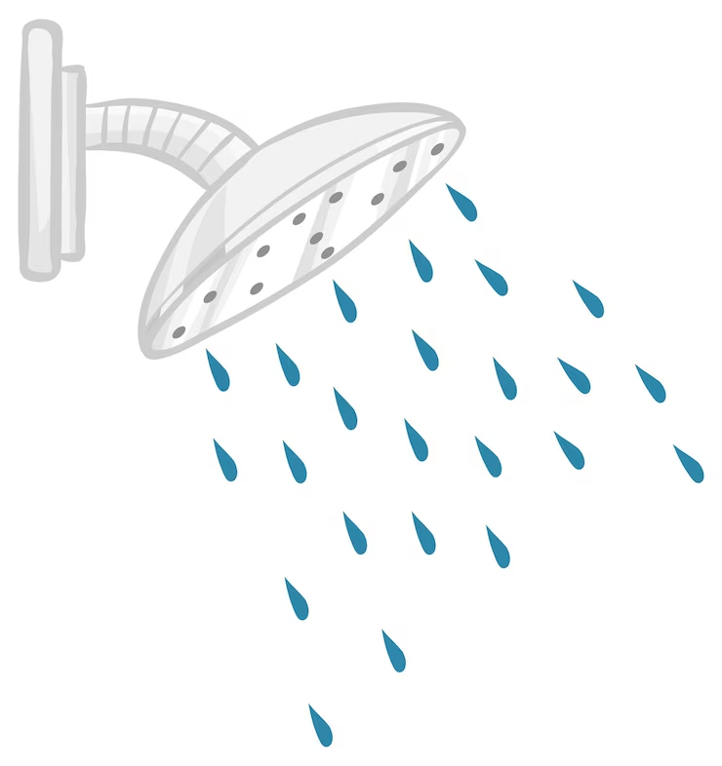
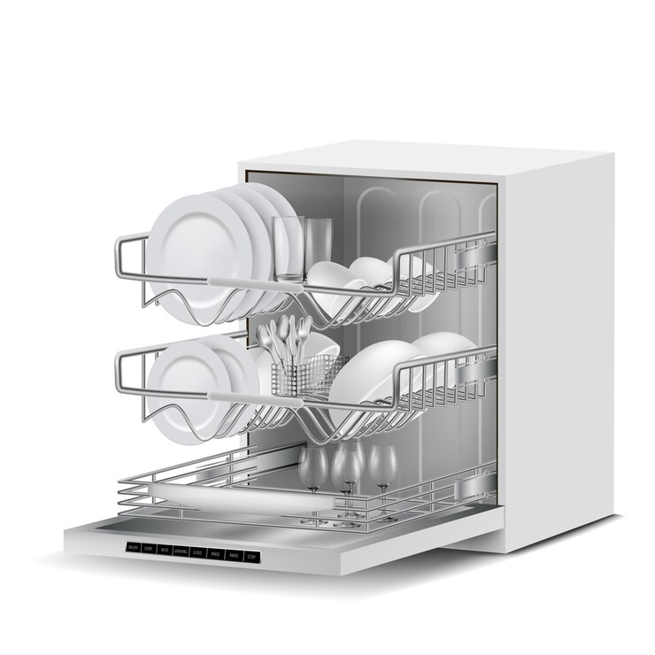
TAKING ACTION AT HOME!
What can you do at home?
There are lots of ways that you can reduce your water usage in your own home.
Make sure that the dishwasher is full and don’t pre-rinse dishes.
Use left over cooking water to water plants.
Switch to showers instead of baths.

Slide 25
IMAGE CREDITS
Slide(s) | Photo | Attribution
2 | Water tap | By Rawpixel.com via Freepik
4 | river | By awesomecontent via freepik
4 | Water storage | By vecstock via Freepik
4 | ground water | By jeswin via freepik
4 | Plug | By zirconicusso via freepik
6 | Science | By Freepik via Freepik
7 | Sink | By kaboompics via freepik
16 | Homework | By Freepik via Freepik
11 | Earth water | By atlascompany via Freepik
13 | Water treatment plant | By wirestock via Freepik
14 | Investigating | By drobotdean via Freepik
19 | Save water | By macrovector via Freepik
20 | Plumber | By vectorjuice via Freepik
20 | Sink | By Freepik via Freepik
21/24 | Water plants | By Freepik via Freepik
22 | Children presenting | By pikisuperstar via Freepik
22 | Document | By pch.vector via Freepik
24 | Shower | By brgfx via Freepik
24 | Dishwasher | By vectorpocket via Freepik

