Slide 1
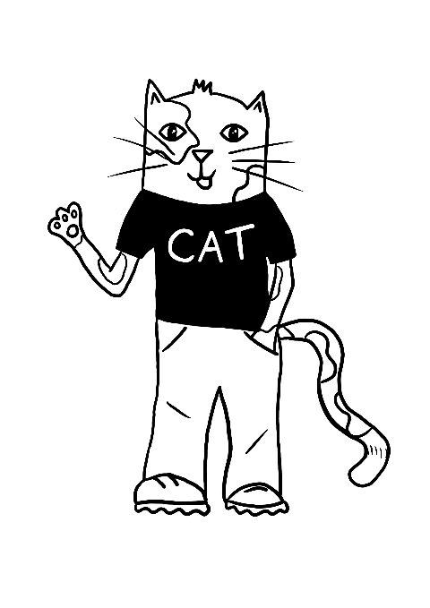
CLIMATE ACTION TEAM
TRANSPORT
Session 1

Slide 2
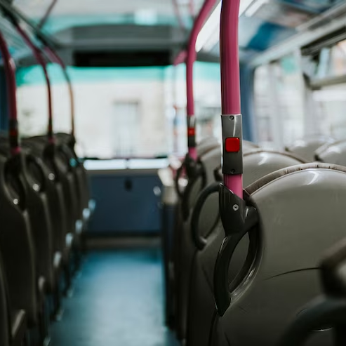
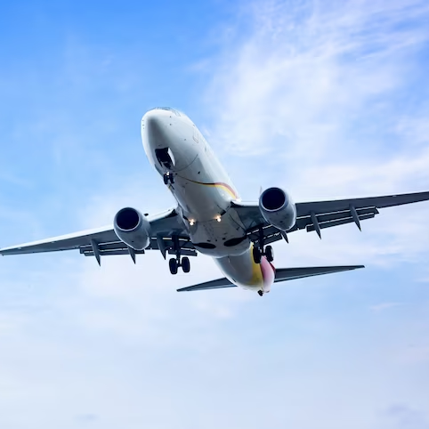
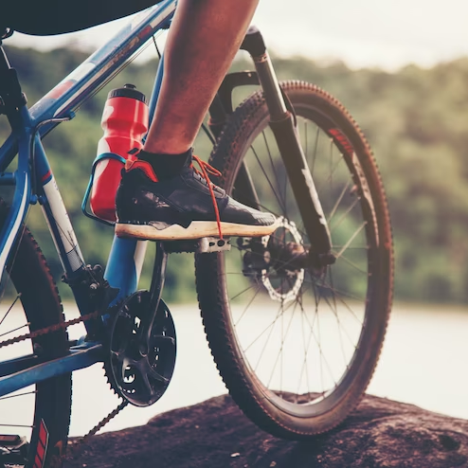
WHAT IS TRANSPORT?
The term transport refers to all the methods people use to move themselves and their goods from one place to another.
Can you think of any other modes of
transport that people might use?

Slide 3
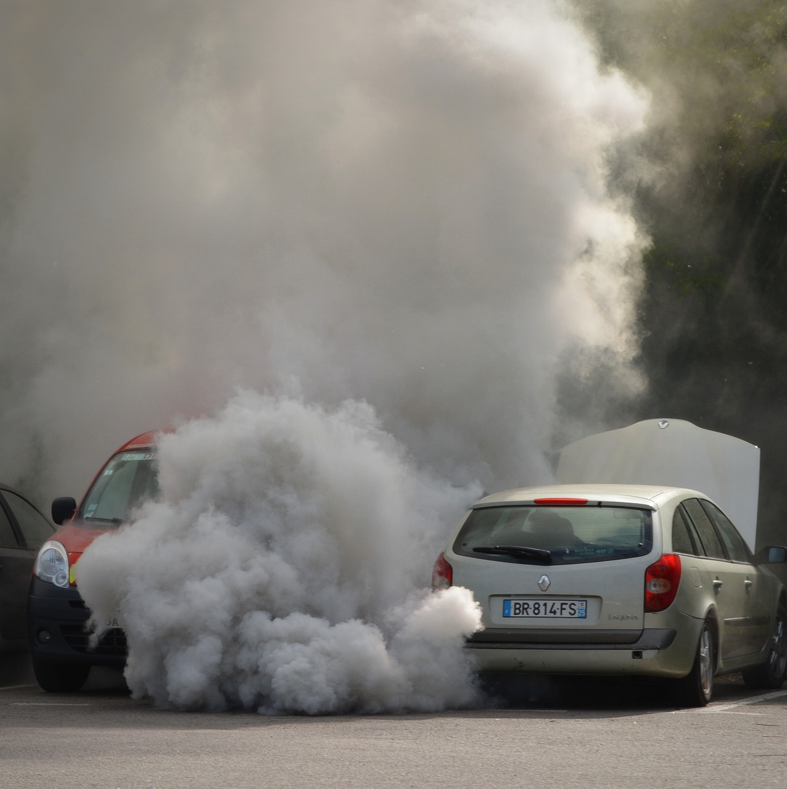
THE IMPACTS OF TRANSPORT
Road transport, like cars and motorbikes, contributes a third of all the UK’s carbon emissions which means that transport is contributing to climate change.
It is damaging the quality of our air and increasing health problems, such as asthma.

Slide 4
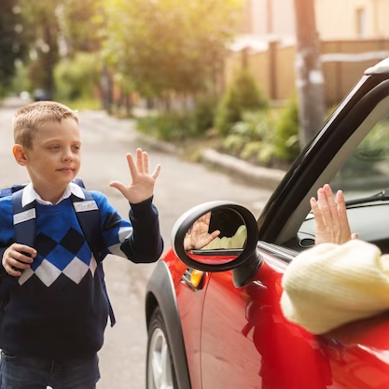
TRAVELLING TO AND
FROM SCHOOL
Do you know how the families at your school get to and from school?
Do you think lots of
them drive to school?
How could we find out?

Slide 5
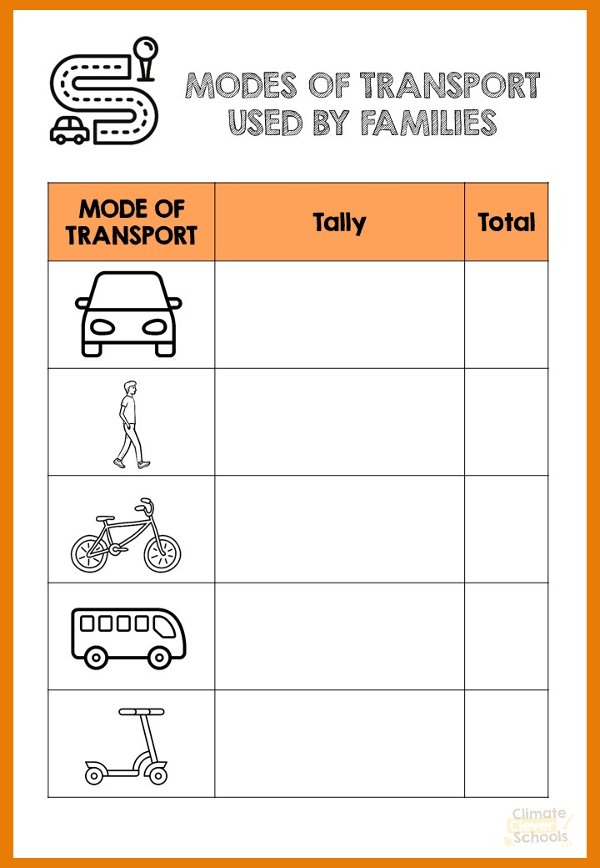
IT’S TIME TO TAKE
SOME ACTION!
As a team, use the tally sheet provided to gather data on the modes of transport used to get to and from school.
You could ask a class each and then collate the data or visit one class at a time as a team.
Once you have collected the data, don’t forget to share your findings with the rest of the school.

Slide 6
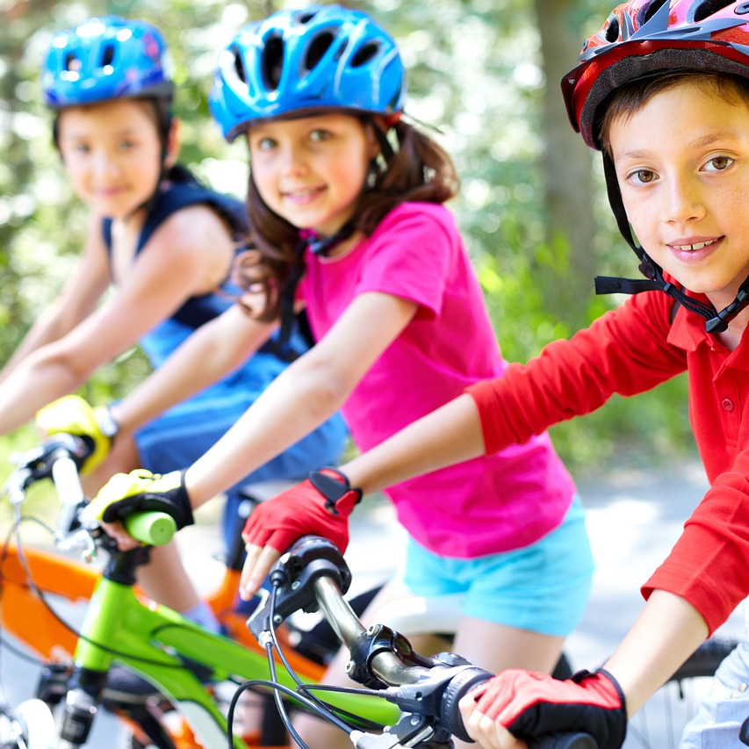
WHAT CAN YOU DO?
Now that you know the impact of road transport on you and the environment, you can start to take action.
It’s time to raise awareness and tell all the families how they can help.
Why not take part in the next Cycle to School Week to raise awareness and send out the information sheet to parents & carers.

Slide 7
CLIMATE ACTION TEAM
TRANSPORT
Session 2

Slide 8
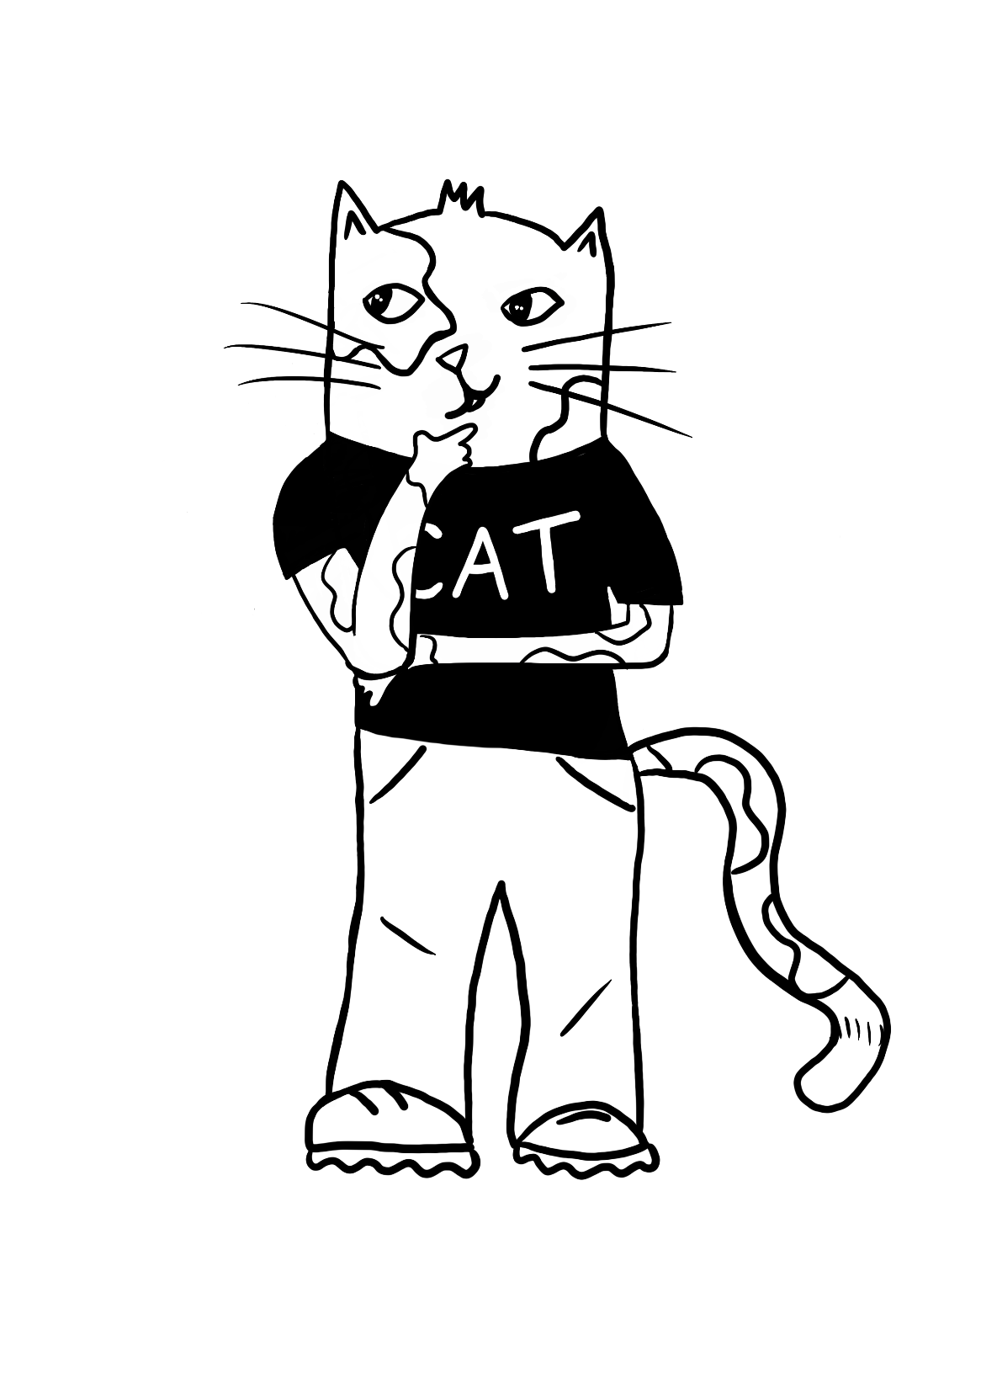
How many modes of transport can you name from last session?

Slide 9
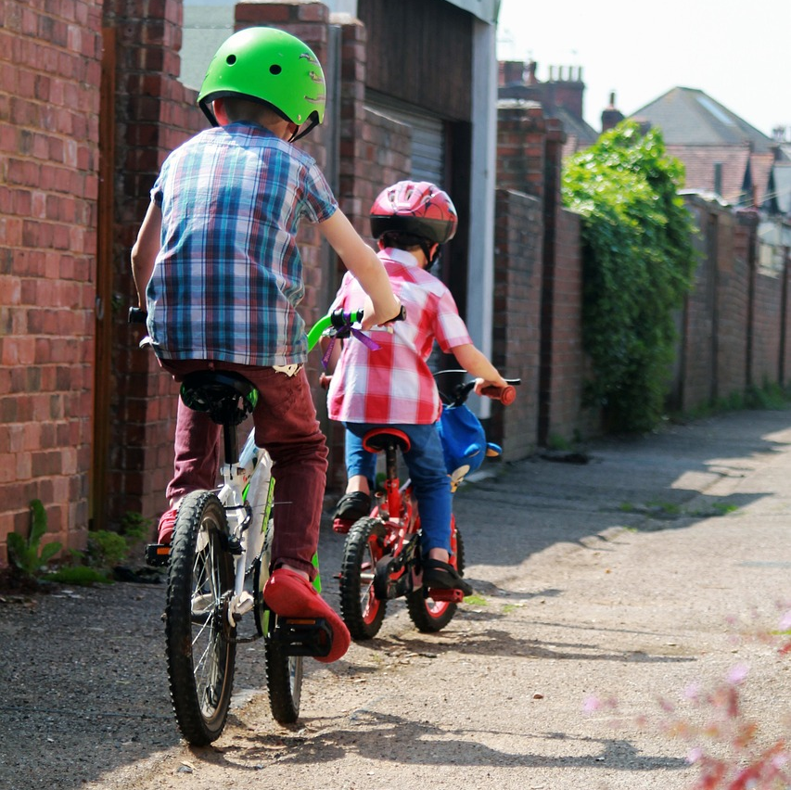
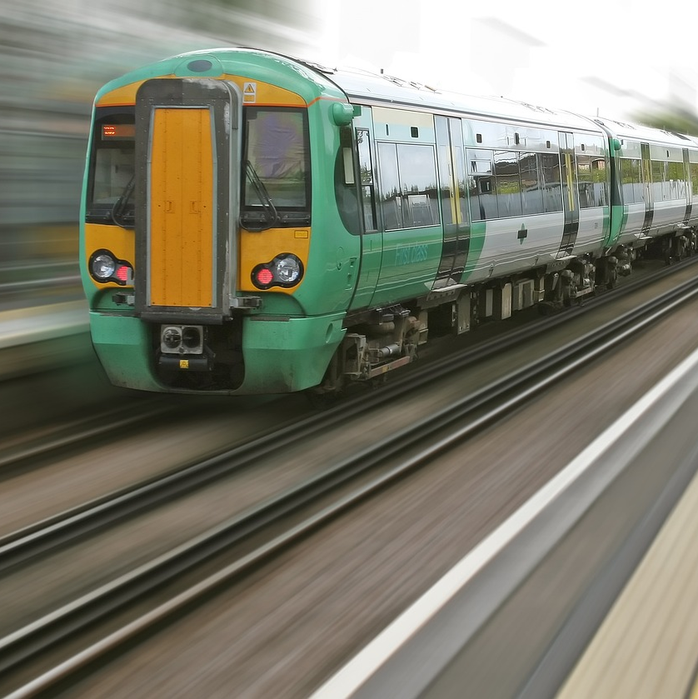
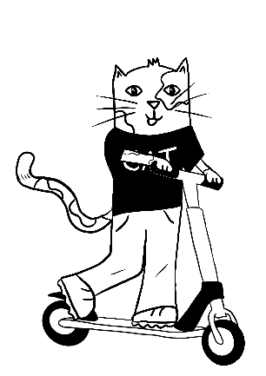
THE LEAST HARMFUL
MODE OF TRANSPORT
Which mode of transport has the least climate impact?
Don’t forget to discuss.

Slide 10
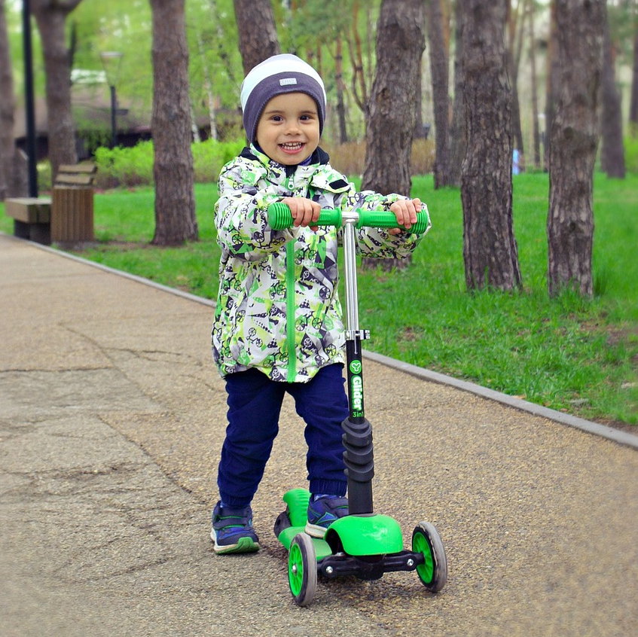
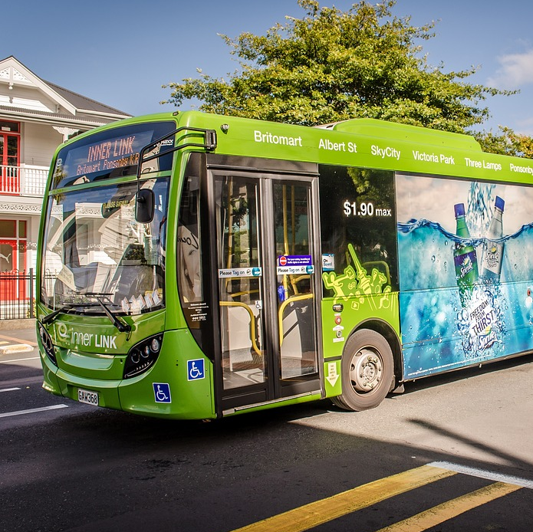
THE LEAST HARMFUL
MODE OF TRANSPORT
Which mode of transport has the least climate impact?
Don’t forget to discuss.

Slide 11
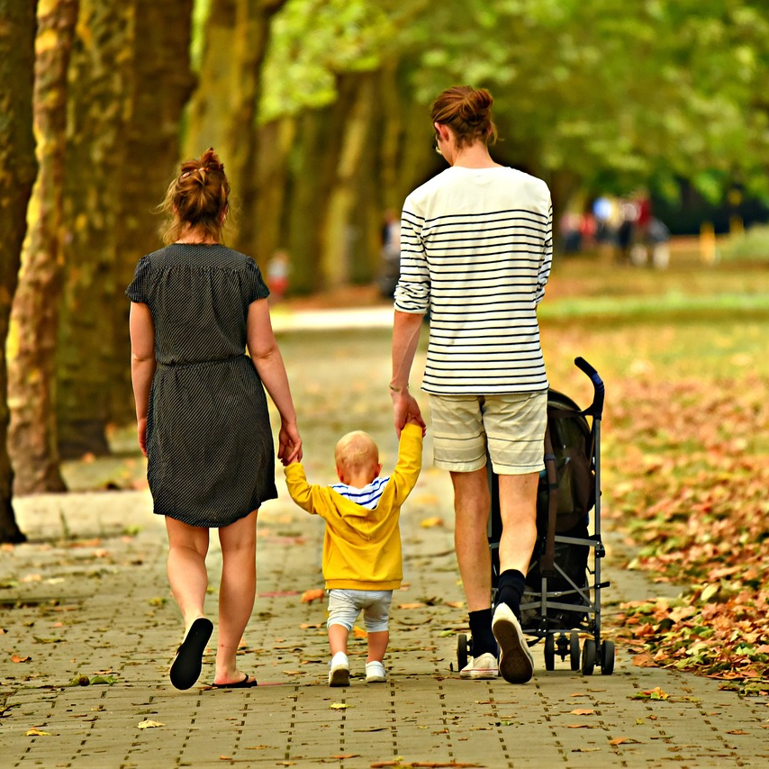
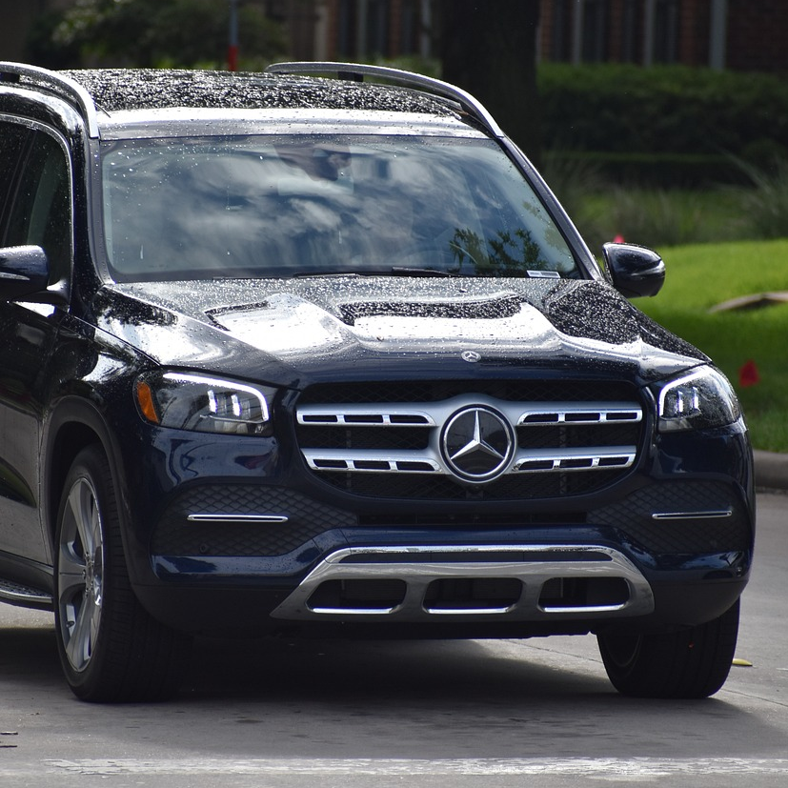
THE LEAST HARMFUL
MODE OF TRANSPORT
Which mode of transport has the least climate impact?
Don’t forget to discuss.

Slide 12
THE LEAST HARMFUL
MODE OF TRANSPORT
Which mode of transport has the least climate impact?
Don’t forget to discuss.

Slide 13
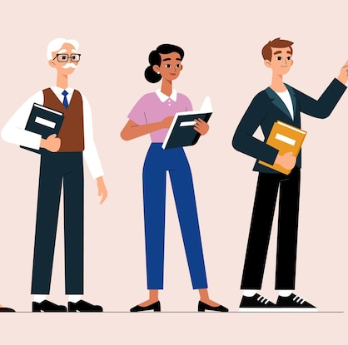
BUT WAIT!
What about the adults in your school?
How do the adults in your school get to and from school?
How can you find out?

Slide 14
IT’S TIME TO TAKE
SOME ACTION!
As a team, use the tally sheet provided to gather data on the modes of transport that adults in school use to get to and from school.
Just like before, you can ask a group of adults each or complete the task together.
DON’T FORGET:
Kitchen staff
Caretaker
Office staff
Lunchtime organisers
Teaching Assistants
Teachers
Head teacher

Slide 15
HOME ACTIVITY
Do the adults in your school community know the impact that their transport might be having on the environment?
Why not create a poster or write an acrostic poem to teach the adults in your school community all about the impact of transport on the climate.

Slide 16
CLIMATE ACTION TEAM
TRANSPORT
Session 3

Slide 17
How do cars harm the environment?
Can you remember?

Slide 18
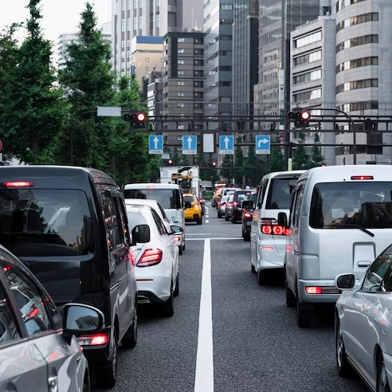
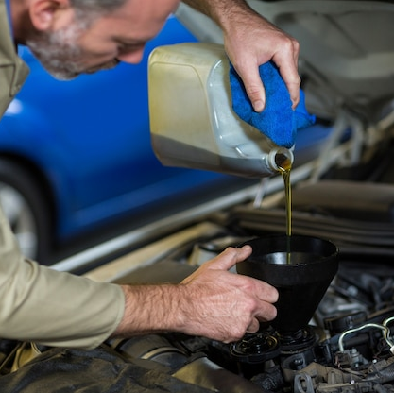
THE DAMAGE CAUSED
Here are a few ways that some forms of transport are damaging the environment.
Exhaust fumes are very harmful and dangerous and are one of the main causes of climate change. They can even cause breathing problems.
Cars and other motor vehicles can be very noisy, especially when there are lots of them together
Fuel and oil spills can be dangerous to other road users and can even end up making its way in to our waterways.

Slide 19
WHAT CAN WE DO?
There are many changes, small and big, that people can make to help protect us and the environment.
Use public transport when you can.
Switch off the engine when the car is stopped.
Use electric vehicles if you can.
Car share where possible.
Check the car regularly to make sure everything is working correctly (no leaks).
Drive slowly to reduce the amount of emissions (fumes).
Walk, cycle or scoot whenever you can.

Slide 20
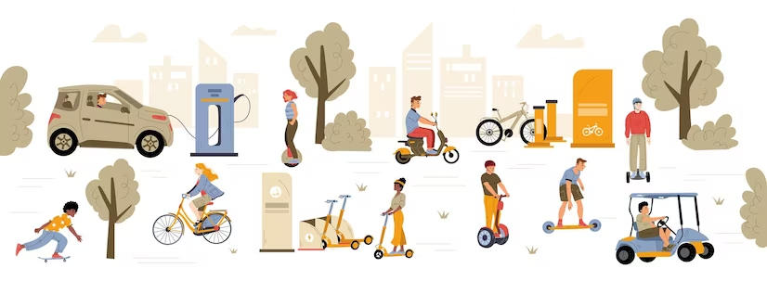
SUSTAINABLE TRANSPORT
What is sustainable transport?
Any transportation that has a low climate impact (sometimes referred to as ‘green’).
Values the environment (has low or zero emissions).
Cares about our world’s natural resources like coal and oil.

Slide 21
SUSTAINABLE TRANSPORT
What is sustainable transport?

Slide 22
IMAGE CREDITS
Slide(s) | Photo | Attribution
2 | Bus | By rawpixel via freepik
2 | Bike | By jcomp via freepik
2 | Plane | By onlyyouqj via freepik
3 | CO2 | By freepik via freepik
3/18 | Car air pollution | By Ben_Kerckx via Pixabay
4 | Child waving | By freepik via freepik
6 | Children on bikes | By SylwiaAptacy via Pixabay
9 | Children on bike | By Pexels via Pixabay
9 | Train | By Shutterbug75 via Pixabay
10 | Scooter | By N-region via Pixabay
10/12 | Bus | By Mampu via pixaby
11 | Family walking | By MabelAmber via Pixabay
11/12 | Car | By ArtisticOperations via Pixabay
13 | Teachers | By Pikisuperstar via Freepik
18 | Cars | By freepik via freepik
18 | Car oil | By peoplecreations via Freepik
19 | Car | By naulicreative via Freepik
20 | Sustainable transport | By upklyak via freepik

