Slide 1
AN INTRODUCTION TO THE
CLIMATE ACTION TEAM

Slide 2
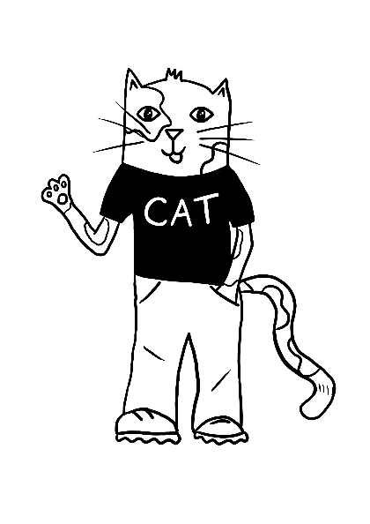
WHAT IS A
CLIMATE ACTION TEAM?
A Climate Action Team, or CAT for short, is a group of young passionate individuals who want to take action against the climate crisis.
YOU ARE LEADING THE CHANGE IN YOUR SCHOOL.

Slide 3
A MESSAGE FROM KAP

Slide 4
MAKING A CHANGE!
What would you like to make a change to?
As a group of young, passionate individuals, you have the power to make a difference.
How would you like to make a change in your school to help with the climate crisis?
Brainstorm some ideas together and take a look at the theme overview to see what you will be getting up to this year as a part of the Climate Action Team.

