Slide 1
WRITING
A WRONG

Slide 2
WHAT HAVE YOU LEARNT SO FAR?
Over the last few sessions, you have learnt all about Skye’s KAPtat campaign but what have you learnt
about the plastic toys in magazines?
Will you buy magazines with plastic toys in the future?

Slide 3
harmful
eliminate
severe
shocking
polluting
AUDIENCE
Who are you writing your letter to?
Remember that you are writing your letter to Ken Murphy the CEO of TESCO.
Your recipients address should be written on the left hand side below your school’s address.
Tesco Headquarters Address:
Shire Park Welwyn Garden City, Hertfordshire AL7TW United Kingdom
You could also research the CEOs of other large
supermarkets and send them a copy of your letter as well.

Slide 4
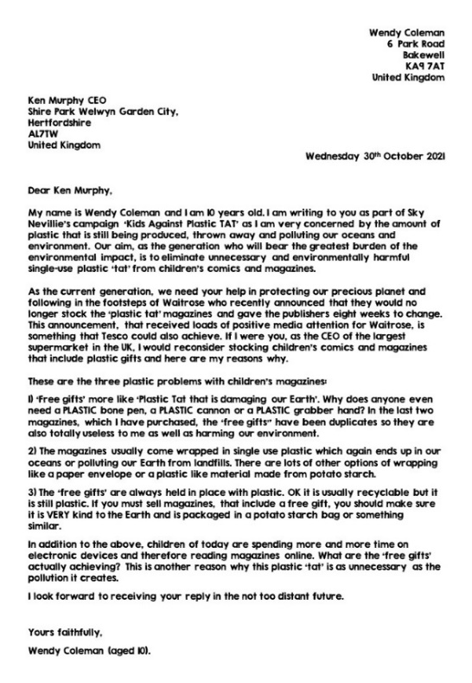
STRUCTURAL FEATURES
You learnt all about structural features in session 2.
How many can you remember?
PARTNER TALK

Slide 5
AUTHOR’S NAME
AND ADDRESS
Your name and address.
RECIPIENT’S ADDRESS
The address of the person you are writing to.
INTRODUCTION PARAGRAPH
A short explanation of why you are writing the letter and the opinion you are going to express.
GREETING
Usually starts with ‘Dear’ if your have the person’s name.
REASONS PARAGRAPH(S)
A paragraph or paragraphs clearly outlining the reason(s) for your point of view.
SIGNIATURE
Close your letter with ‘Yours faithfully’ if you don’t know the recipient or ‘Yours sincerely’ if you do know the recipient.
CONCLUSION
A final statement, summing up your argument and recapping your point of view.

Slide 6
harmful
eliminate
severe
shocking
polluting
WRITING A WRONG
Let’s get writing!
Skye can’t wait to hear all about the letters that you send to Tesco and other companies.
Don’t forget to fill out the form on the KAPtat webpage to get a special thank you email from KAP.
Let pupil power meet pen power!

Slide 7
IMAGE CREDITS
Slide(s) | Photo | Attribution
5 | Arrows | Brgfx at freepik.com

