Slide 1
FEATURES OF A PERSUASIVE LETTER

Slide 2
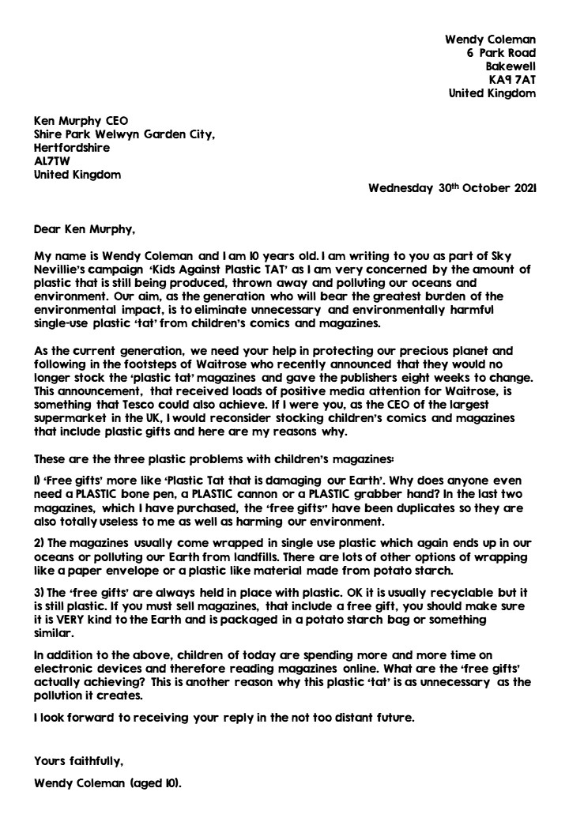
WHAT IS A PERSUASIVE LETTER?
What do you already know about persuasive writing?
A persuasive letter is a letter which attempts to convince the reader to agree with the author by arguing a point of view.
There are lots of features of a persuasive letter which your letter must include.

Slide 3
PURPOSE
Every persuasive letter must have a purpose. A purpose means that you have a reason for writing the letter.
In 2021, Tesco were very close to following Waitrose’s lead and banning comics with plastic tat but they never went ahead with the ban.
We hope, with a bit of encouragement from children, young people and adults, that we can persuade them to go ahead with the ban.
If Tesco make the ban, then other large supermarkets will hopefully follow.

Slide 4
AUDIENCE
Now that you have a purpose, you need to know your audience. The intended audience means the person or people that you are writing to and those who you expect to engage with the letter.
Ken Murphy is the current CEO (chief executive officer) of the largest supermarket in the United Kingdom, Tesco.
‘Every little helps’ is Tesco’s slogan so let’s see if we can get Ken Murphy to help the environment by banning comics and magazines with plastic ‘tat’ in all Tesco stores.
Every little change helps to protect the world.

Slide 5
STRUCTURAL FEATURES
The structural features refer to the way that that letter is set out on the page.
Can you name any structural features?

Slide 6
AUTHOR’S NAME
AND ADDRESS
Your name and address.
RECIPIENT’S ADDRESS
The address of the person you are writing to.
INTRODUCTION PARAGRAPH
A short explanation of why you are writing the letter and the opinion you are going to express.
GREETING
Usually starts with ‘Dear’ if your have the person’s name.
REASONS PARAGRAPH(S)
A paragraph or paragraphs clearly outlining the reason(s) for your point of view.
SIGNIATURE
Close your letter with ‘Yours faithfully’ if you don’t know the recipient or ‘Yours sincerely’ if you do know the recipient.
CONCLUSION
A final statement, summing up your argument and recapping your point of view.

Slide 7
BECOME A STRUCTURAL
FEATURE DETECTIVE.
Using what you now know about the structural features of a persuasive letter, piece together the ‘Writing a Wrong’ example letter and label it with the different features.
CHALLENGE – Quiz a friend on the different structural features.
You could even write clues about each feature for them to solve.

Slide 8
IMAGE CREDITS
Slide(s) | Photo | Attribution
5,6 | Arrows | Brgfx at freepik.com

