Slide 1
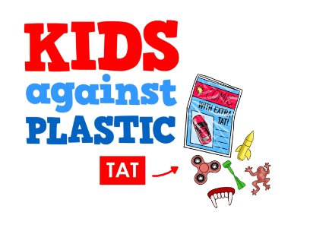
WHAT IS KAPTAT?

Slide 2
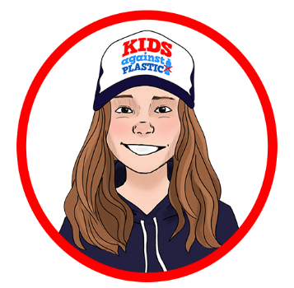
MEET SKYE NEVILLE
Chief Campaigns Officer at Kids Against Plastic
My name is Skye Neville and I’m 12 years old. You may remember me from the news last year when my campaign to get plastic toys off magazines got the attention of supermarkets and publishers across the UK.
I got a great result - Waitrose committed to stop selling magazines with plastic toys.

Slide 3
harmful
eliminate
severe
shocking
polluting
PLASTIC ‘TAT’
But why is Skye campaigning about plastic toys on magazines?
Well let’s let Skye, along with the
cofounders of Kids Against Plastic tell you why.

Slide 4
SO LET’S RECAP
There are lots of reasons why plastic toys, or plastic ‘tat’, should be banned from magazines and comics.
Harming the environment
Large
carbon footprint
Unethical
Polluting Oceans

Slide 5
harmful
eliminate
severe
shocking
polluting
WHAT CAN YOU DO TO HELP?
Skye is here to tell you how you can help.
Skye and Kids Against Plastic need your help.
The world needs your help!

Slide 6
IMAGE CREDITS
Slide(s) | Photo | Attribution
4 | Thumb down | Rawpixel.com at freepik,com

