Slide 1
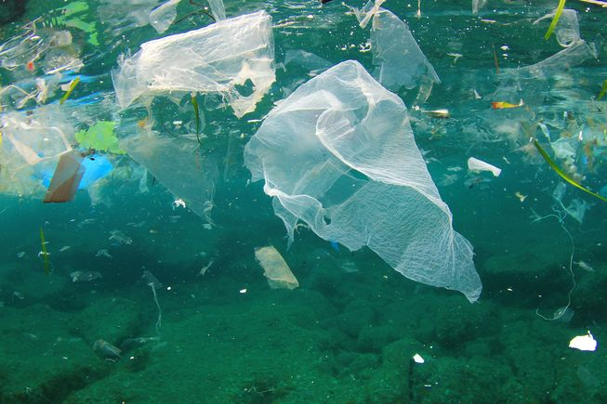
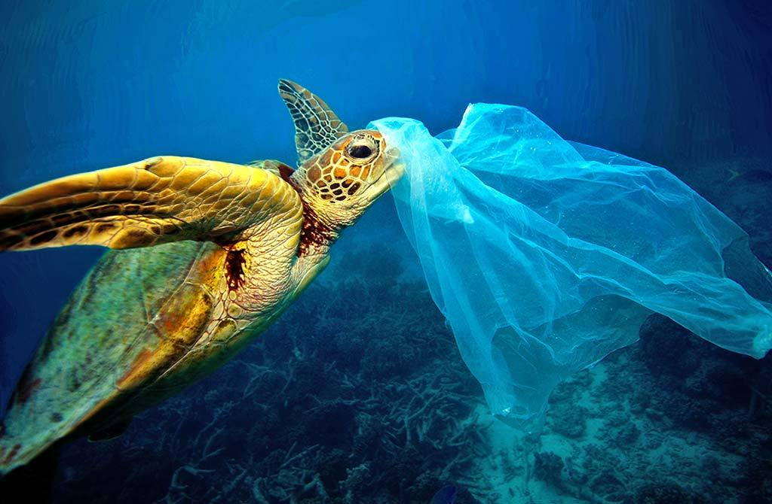
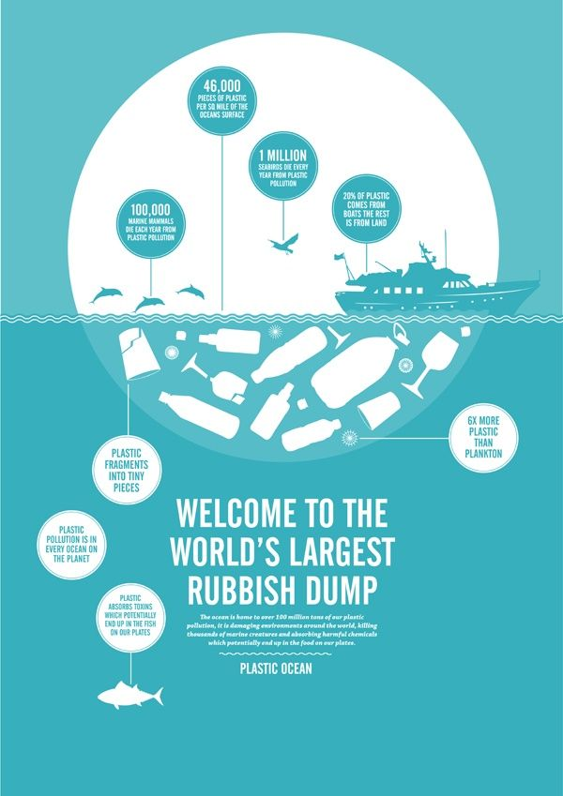
A plastic ocean: plastic pollution
What is plastic doing to our world?

Slide 2
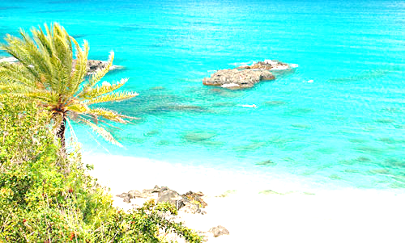
Why it matters to me
I love the ocean and the sea and I am a keen snorkeller. I enjoy swimming in the oceans when on holiday and I especially love eating seafood and fish! Now the beauty and adventure of the sea is quickly being destroyed by us. This is putting all these enjoyable things about the sea in danger. We have only discovered 8% of the sea and have managed to kill almost all of it. In 2016 The Great Barrier Reef in Australia was declared officially ‘dead’. Plastic pollution was one of the causes of this.
The film ‘ A Plastic Ocean’ shows us how what we are doing to the oceans and how much it hurts the world and environment. I am doing my TED talk on this subject to promote the film and spread the word about plastic pollution. It has also shown me how serious this problem has become and how it is a race against time.

Slide 3
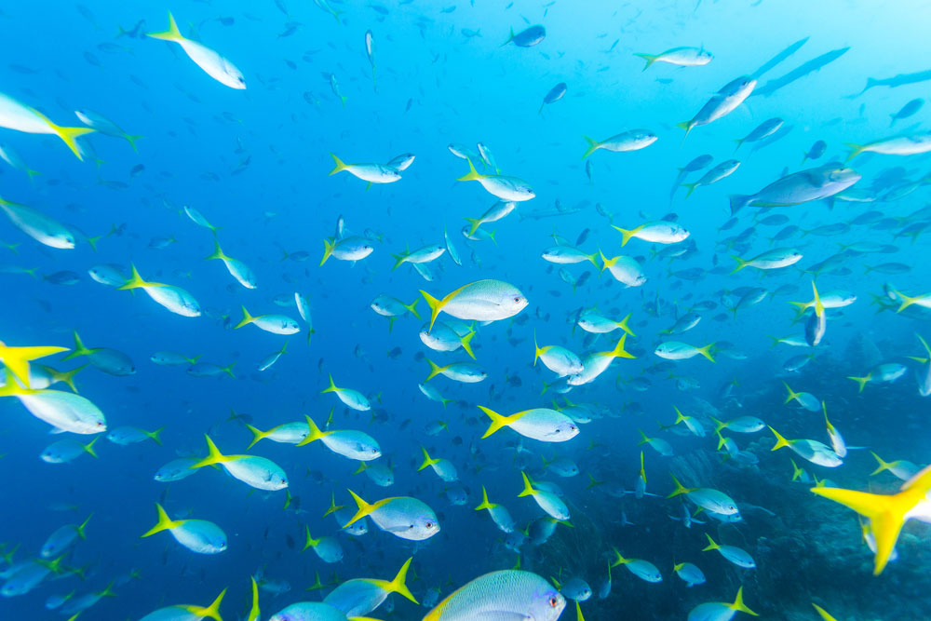
Why it should matter to you
How many people like eating seafood or fish?
If you do then here’s something to think about: most marine animals in the ocean have mistaken plastic particles for food and, therefore, when we eat the fish or seafood we are eating the plastic particles they digested.
Globally we produce 280 million tonnes of plastic every year, of which 20 million tonnes ends up in the ocean.
An estimated 5.25 trillion plastic particles, weighing over 250,000 tonnes, are floating in the ocean now. If eaten large quantities, the plastic particles may be poisonous, cause infertility and disrupt the genes of marine life and the humans that eat them too.
5 major ocean gyres, the largest of which is the North Pacific gyre, which now has 6 parts plastic for every 1 part natural plankton. Plankton is responsible for producing more than 50% of the oxygen in our atmosphere.
Plastic pollution results in over US$13 billion of damage to marine ecosystems every year.

Slide 4
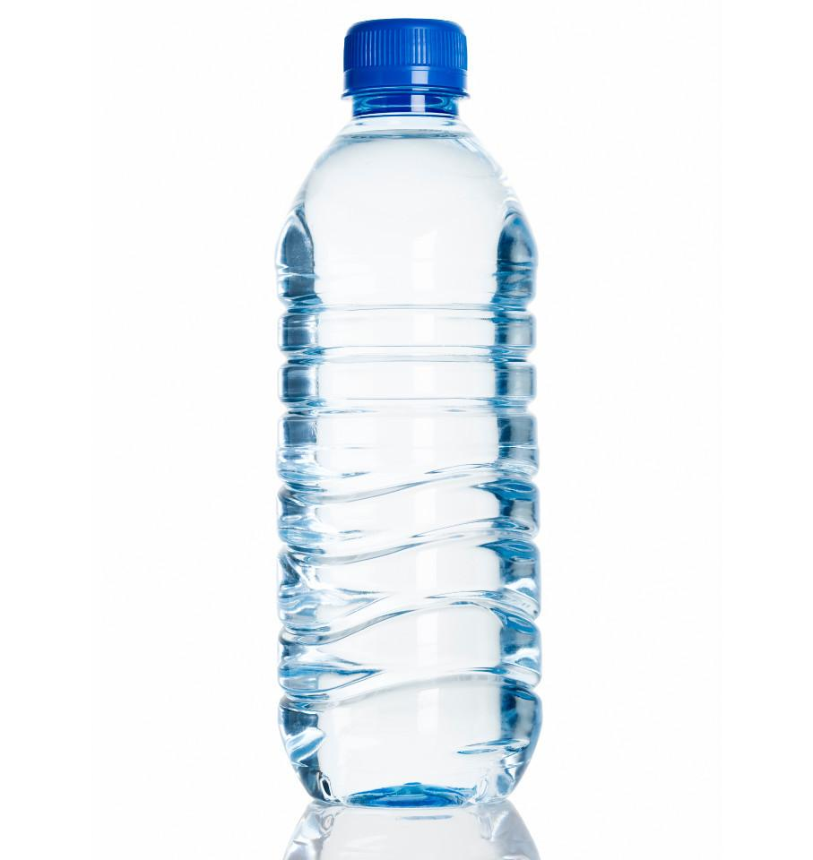
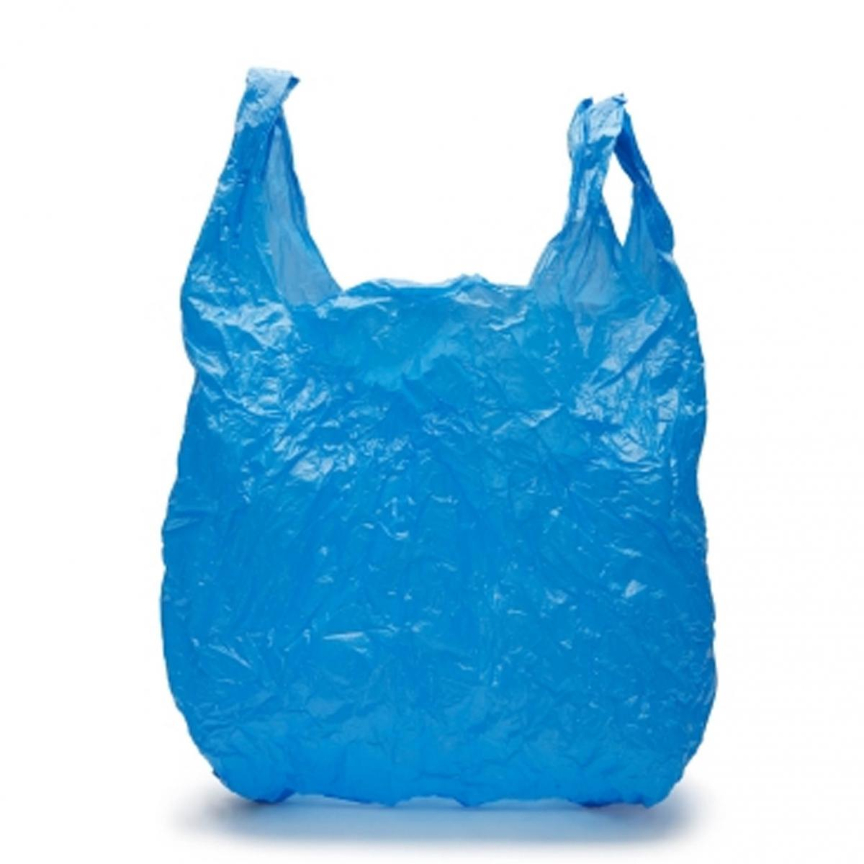
What is it?
Amongst the items harming our oceans are:
Single use plastics such as:
Straws.
Plastic carrier bags.
Plastic water bottles.
Plastic micro-beads found in some toothpastes, facial wash and other toiletries. They will be banned from sale in the UK by the end of 2017, but much damage has already been done because of them.
Plastic can binders/holders.

Slide 5
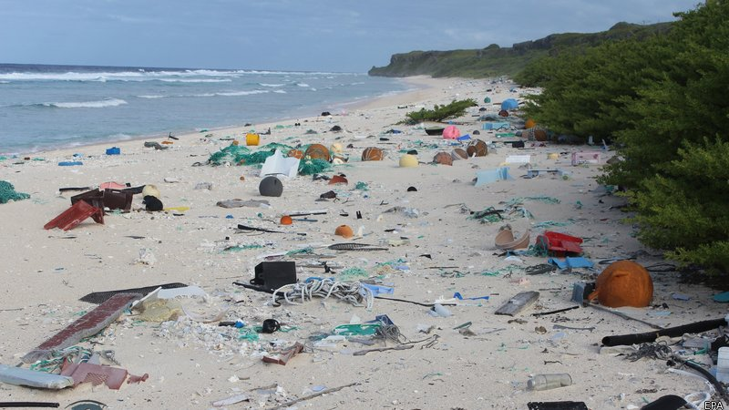
Where does this come from?
Plastic pollution comes from:
Our litter, such as overflowing bins near beaches.
Poorly managed waste discharges, and litter blown by the wind.
Sewage systems that feed into the sea.
Packaging and lost crates from cargo ships.
All of this plastic causes harmful pollution and it is directly caused by us.

Slide 6
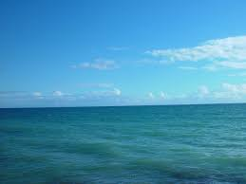
Our seas
1.They hold 97% of our Earth’s water.
2. 70% of the world’s oxygen comes from the sea.
3. 97% of the world’s sewage goes straight into the ocean.
4. The ocean is the most powerful force on the planet.
5. At the moment the ocean is our largest rubbish tip.

Slide 7
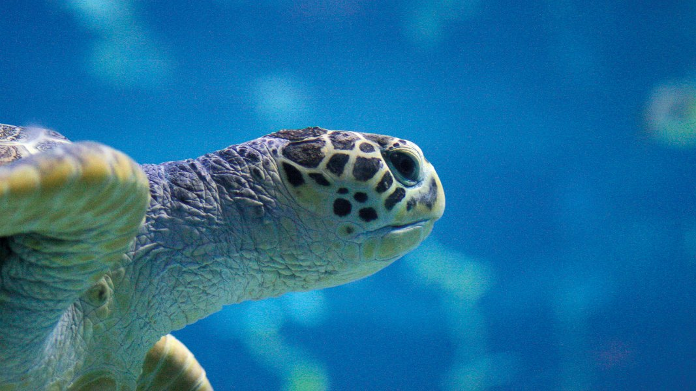
Sea life
Plastics injure and kill fish, sea birds and marine mammals.
693 species of marine life have been affected including all seven species of sea turtle, nearly half of marine mammals, 20% of all seabird species.
Every year over 100,000 marine mammals and 1 million seabirds are killed by marine debris.
A lot if sea life are eating plastic, getting trapped and caught up in plastic or getting plastic stuck to or inside them.

Slide 8
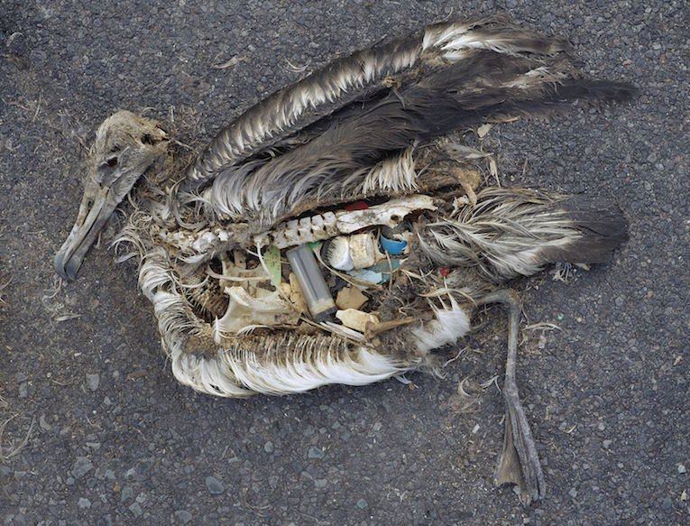
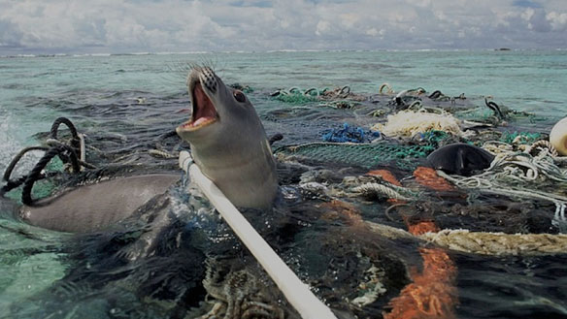
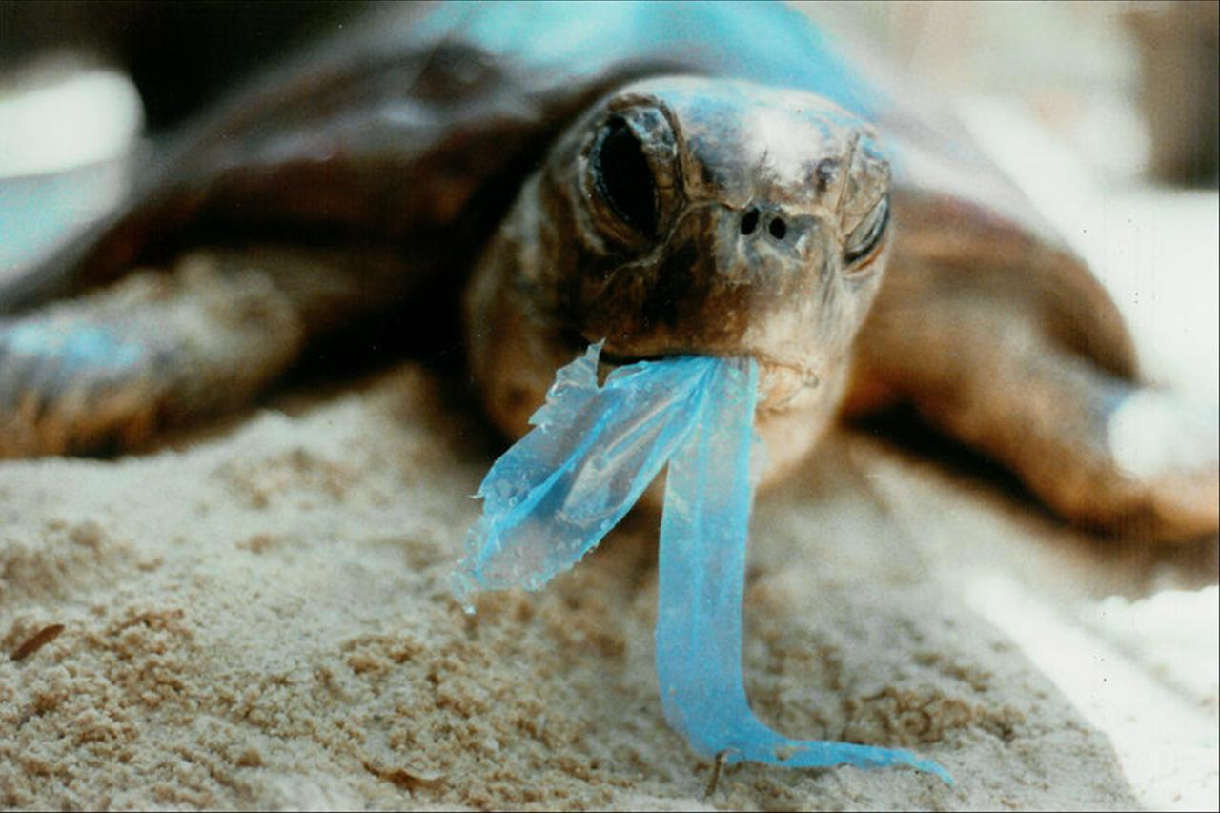
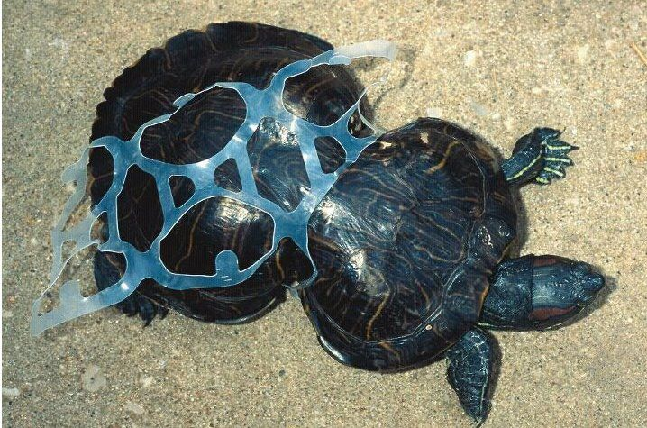
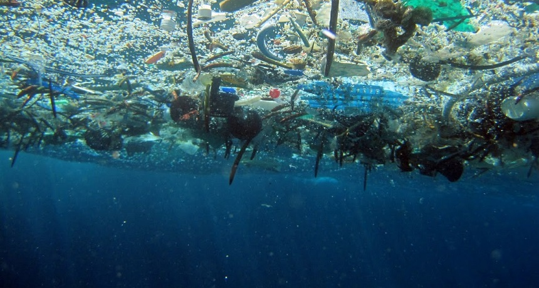
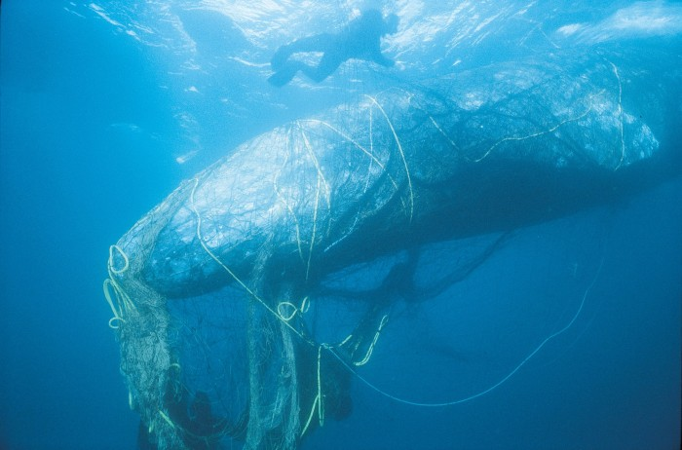
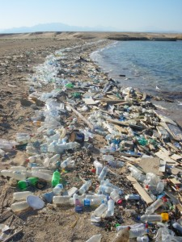
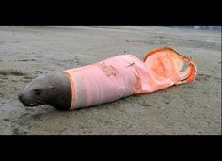
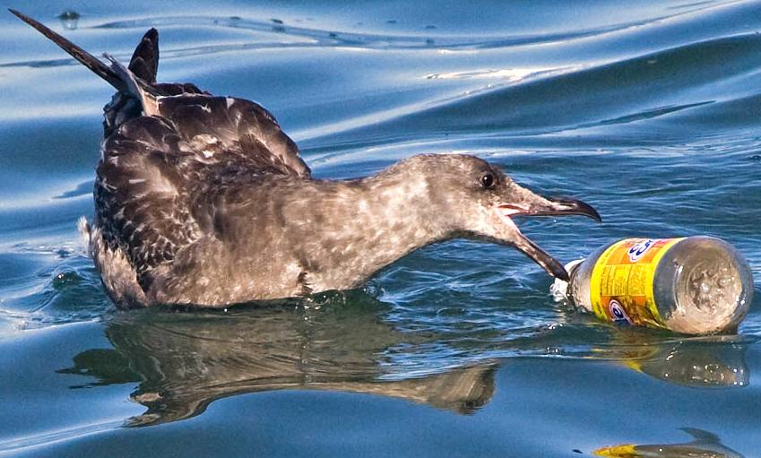
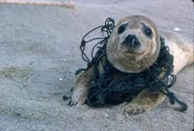
This is what rubbish is doing to sea life

Slide 9
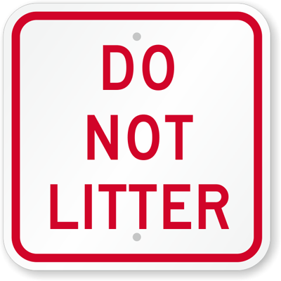
What can we do?
There’s loads we can do to stop this situation getting any worse. We can:
Refuse to use plastic straws
Buy a reusable water bottle and fill it from a tap or fountain
Don’t litter – especially plastics
Litter pick – one item per person a day will make a difference
Remember the 4 Rs – Refuse, reduce, reuse, recycle
Avoid synthetic fabrics
Avoid products containing micro-beads
SPREAD THE WORD

